Slide 1


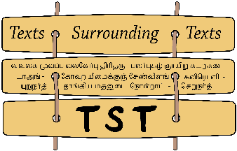


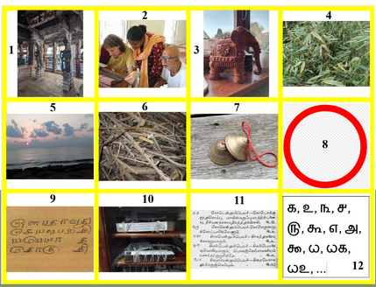
How to Make Good Use of an Ancient Tamil Poetic Vocabulary while Preparing a Dictionary of Classical Tamil
Tamilex
Eva Wilden (Hamburg) and Jean-Luc Chevillard, (Tamilex and HTL)
Séminaire Mondes Indiens, 3 December 2025, Paris

Slide 2
How to Make Good Use of an Ancient Tamil Poetic Vocabulary while Preparing a Dictionary of Classical Tamil
Jean-Luc Chevillard
(Tamilex and HTL)
Séminaire du Monde Indien
Paris, 2025/12/03

Slide 3
Although the roots of Tamil lexicography lie inside the Tolkāppiyam, the Tivākaram (possibly 8th cent.) is the oldest among those Classical Tamil texts referred to as Nikaṇṭu-s. Its initial part is thematically organized and divided in ten sections: (1) divine names, (2) human beings, (3) animals, (4) plants, (5) places, (6) natural items, (7) artefacts, (8) qualities, (9) actions, (10) sound. These are followed by a section on polysemic words and a section devoted to Bhūtasaṃkhyā-s, i.e. collections of items symbolically associated with a given number.
The current presentation will visit the Tivākaram both as a target and as a predecessor of the recently started Tamilex project, which consists in preparing a First-Millennium Classical Tamil dictionary. It will raise and try to answer questions concerning, among other things, its macrostructure, its microstructure, its coverage, its interpolations and its intended use.

Slide 4
What is Classical Tamil? (a few figures)
The language of a corpus which has been transmitted until today, although with some vicissitudes
Caṅkam literature (8 tokai and 10 pāṭṭu) (8+10=18)
Tolkāppiyam (consisting of 3 books having 9 chapters each)
The 18 kīḻ-kaṇakku (including the famous Kuṟaḷ)
The Peruṅkāppiyaṅkaḷ (said to be FIVE)
Devotional literature (śaiva and vaiṣṇava) (12 TM
Tivākaram and the other Nikaṇṭu-s

Slide 5
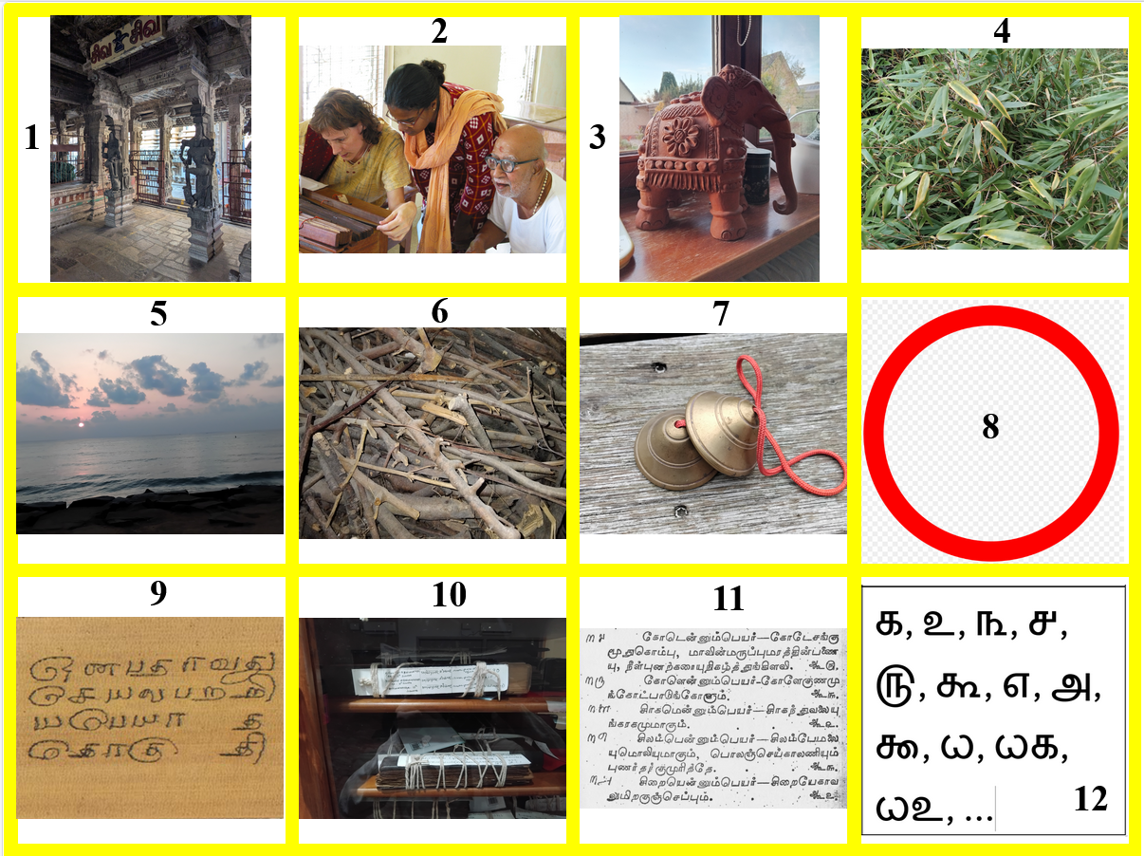
The thematic section of the Tivākaram and the rest
(1) divine names
(2) human beings
(3) animals
(4) plants
(5) places
(6) natural items
(7) artefacts
(8) qualities
(9) actions
(10) sound
(11) polysemy
(12) groups

Slide 6
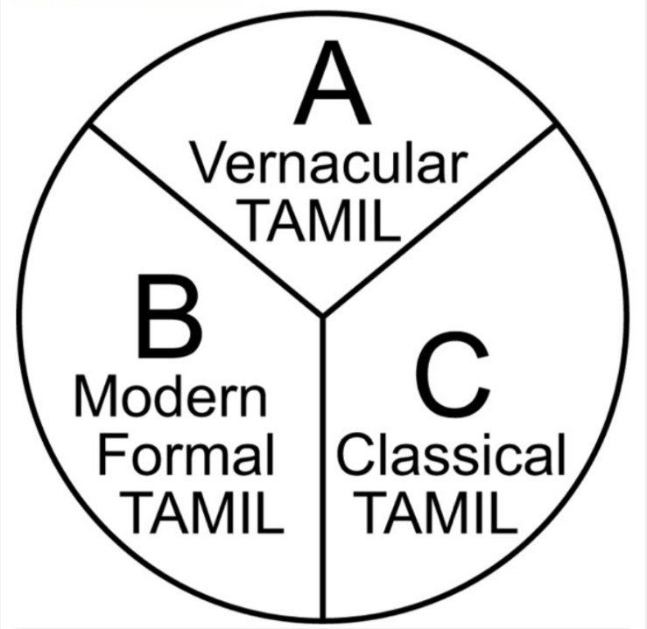
The place of Classical Tamil inside the Tamil triglossia

Slide 7
Which varieties of Tamil have been described or characterized across history?
Traditional Tamil śāstric literature deals only with Classical Tamil, and mostly with Poetical composition (ceyyuḷ), although current usage (vaḻakku) is also occasionally mentionned.
The colloquial variety of the Tamil language was not described before the arrival of western missionaries, who were the first to produce grammars and dictionaries for it, starting with Henrique Henriques (16th c.), Balthasar da Costa and Antam de Proença (17th c.)
In the 18th century, Beschi understood the importance of செந்தமிழ் and started to describe it, drawing inspiration from traditional scholarship (grammars and nikaṇṭu-s)

Slide 8
Ziegenbalg‘s testimony concerning the Tivākaram
Diwagaram, ein poetisches Buch, so da copiam verborum in sich fasset, und am allerersten von der Jugend in ihrem 8. oder 9. Jahre gelernet wird. Der Autor dieses Buchs heißt Diwagaram und ist einer von der Schammaner Nation gewesen, […] Dieses Buch lernen allein diejenigen, so da wollen Gelehrte werden, oder doch solche Leute seyn, die mit Gelehrten umgehen und ihre gelehrte Sprache verstehen wollen. Die gemeinen Malabaren verstehen kein Wort aus selbigen oder doch ganz wenig.
(Bibliotheca Malabarica [ca. 1706–1708]
Sweetman and Ilakkuvan 2012: 50, BM 4 [original text])

Slide 9
Ziegenbalg‘s testimony concerning the Tivākaram
Tivākaram, a poetic book containing copiam verborum, and studied by the youth at the earliest in their eighth or ninth year. the author of this book is called Tivākaran and was one of the camaṇar nation. […] His book is studied only by those who wish to become scholars, or those who interact with scholars and wish to understand their language. The common Malabarians understand not a word of it, or at least very little.
((Bibliotheca Malabarica [ca. 1706–1708]
Sweetman and Ilakkuvan 2012: 50, BM 4 [translation])

Slide 10
Beschi‘s testimony (Caturakarāti preface, 1732)
Thesaurus // Linguæ Tamulicæ // Ad pleniorem planioremq. // Scriptorum Tamulensium // Intelligentiam. // a.D. // M.D.CC.XXX.II. // Præfatio. //
Quamquam in omni sanè disciplinà primum // et præcipuum sit, cujuscumque artis præcepta ordine // digesta tradere tradere : nil tamen proderit tradidisse // nisi et materiam suggeras et instrumenta, quibus ad // praxim redigentur præcepta. quod autem Pictoribus - // colores, militibus arma, opera extruentibus calx, saxa, // et hujusmodi plura, hoc planè sunt peregrino ser= // moni studentibus verba. nihil propterèa præstasse // me crediderim, cum vulgaris simul ac elegantioris // Tamulici idiomatis artes fusè scripserim; nisi et ver- // =borum copiam per Dictionaria tradam: quod profectò // animadvertens in utriusq.e dialectûs Grammaticã et // lexicon promiseram: serò nunc quidem, sed cum favore // promissa reddo. [Beschi, 1732])

Slide 11
Beschi‘s testimony (Caturakarāti preface, 1732)
While with regard to every discipline, truly, what is first and most important is to transmit the rules of any art arranged according to an order: it will benefit in no way to have transmitted [such rules], unless you supply also the matter and the instruments through which the rules can be turned into practice. And indeed, what colors are to painters, weapons to soldiers, lime and stone to construction workers, and many other things of the like, this is clearly what words are to students of a foreign language. Therefore, I would have thought of having accomplished nothing, by having composed profusely the grammars (artes) of both the colloquial (vulgaris) and literary (elegantioris) [registers] of the Tamil language (Tamulici idiomatis), unless I had not also transmitted the wealth of words through dictionaries (Dictionaria): since I know very well that I had promised a grammar (Grammaticam) and a dictionary (lexicon) of both dialects. [Beschi, 1732] (Translation: Trento & Chevillard , 2025)

Slide 12
Beschi‘s testimony (Caturakarāti preface, 1732)
Now, certainly with delay, I deliver what I had promised. Indeed, in addition to the dictionary of the colloquial language (Vulgaris linguæ lexicon), where I explain whatsoever entries in Latin, French and Portuguese, here furthermore 1) I hand over a dictionary (Dictionarium), where the twofold or even multiple meaning and signification (vis ac potestas) of all the words will be determined, as long as these are established from the writers of literary Tamil and in abundance.
[Beschi, 1732] (Translation: Trento & Chevillard , 2025)

Slide 13
Beschi‘s testimony (Caturakarāti preface, 1732)
2) (A book of) synonyms (Synonyma), where I list those nouns, and especially the periphrasis, which are associated by those same authors to each thing. 3) Moreover, since in this language many things are expressed by a (numerical) sum, so that two [are] the goods, three the worlds, four the forts, five the senses, six the flavors, seven the seas, eight the mountains, and many other things in this way, which are found scattered in the literature; so, you will find explanation [of all this] in the third book.
[Beschi, 1732] (Translation: Trento & Chevillard , 2025)

Slide 14
Beschi‘s testimony (Caturakarāti preface, 1732)
4) Finally, for the purpose of poetry, I present gathered as one group the words, whose [initial] syllables only differ in the first letter, and end with the same syllables and the same sound. Therefore, it pleased [me] to call this volume “A Treasure (Thesaurum) of the Tamil Language”. And since all of these [words] are organized according to the Tamil alphabet, and the work is divided into four parts, we have entitled it Caturakarāti in Tamil.
[Beschi, 1732] (Translation: Trento & Chevillard , 2025)

Slide 15
Beschi‘s testimony (Caturakarāti preface, 1732)
In order to serve the indigenous people well, I explain the Tamil entries in Tamil; however, in the explanations I have used, as far as permitted, common words in the colloquial language: and I will always present with a colloquial expression those [words] whose synonyms and periphrases I intend to give, [as this is something] that I judged would not be useless for the Europeans. In fact, as I believe, someone ignorant of the colloquial register should not have the presumption to access the more elegant [register] by leaps.
[Beschi, 1732] (Translation: Trento & Chevillard , 2025)

Slide 16
Beschi‘s testimony (Caturakarāti preface, 1732)
On the other hand, since this language [register] is, as they say, dead, it is not from the recent speech of men, but from the surer antiquity of written tomes that the strength and power of its words will be drawn out. For this reason, I thought I should not in any way rely on men of this time, but that I have gone through the volumes of the old Tivākaram—[Cūṭāmaṇi] nikaṇṭu—Piṅkalantai—Uriccol—Kaiyātaram and others like them with the greatest possible diligence, because all are [Collections of] synonyms (synonima [sic!]), not Dictionaries (Dictionaria).
[Beschi, 1732] (Translation: Trento & Chevillard, 2025)

Slide 17
Beschi‘s testimony (Caturakarāti preface, 1732)
In addition, I consulted, in a thorough reading, the most learned commentators of the writers, and as by the negligence of the copyists many errors had crept in, I compared between the books written by different hands. Finally, as many and many words came from the grandonic language , I tried, also by reading with care the grandonic authors, to correct according to the norm of truth those errors that had crept in, and, by drawing a quantity of words from the same treasure, I tried to enrich even more this Thesaurus.
[Beschi, 1732] (Translation: Trento & Chevillard , 2025)

Slide 18
Beschi‘s testimony (Caturakarāti preface, 1732)
And so I offer this work, which I have composed with as much diligence as I could, and with no less effort, to the missionaries of Jesus Christ; and how useful it will be to them, everyone can easily know, if they have observed for a moment how in these regions the chronicles of the Gods, the fictions of their fables, the precepts of science, the poems of the poets, the calculations of astronomy, the rules of medicine, the rules of music and dance, in short everything, and even the first rudiments of grammar, were written by the ancients in this more elegant register.
[Beschi, 1732] (Translation: Trento & Chevillard , 2025)

Slide 19
Beschi‘s testimony (Caturakarāti preface, 1732)
Wherefore no one may know fully and without hesitation of mind anything at all of their Gods and fables, of their arts and sciences, if they are deeply ignorant of this idiom. […] And indeed, the ancient Tamils have talked about God and virtue in a sensible way. But how can you [convince anyone], if you are completely ignorant of the elegant register of the Tamil language, in which truly all the things are written?
[Beschi, 1732] (Translation: Trento & Chevillard, 2025)

Slide 20
Reading a verse and linking its words to the Tivākaram (trying to imagine the life of one who has memorized the Tivākaram)
maṉṉuyi rellān tuyiṟṟi yaḷittirā // veṉṉalla tillai tuṇai (Kuṟaḷ 1168)
maṉ uyir ellām tuyiṟṟi aḷittu irā eṉ allatu illai tuṇai
Maṉṉal: Ti-9_69, Ti-11_351
Uyir: Ti-2_233
Ellām: Ti-8_25
Tuyiṟal: Ti-9_18,19

Slide 21
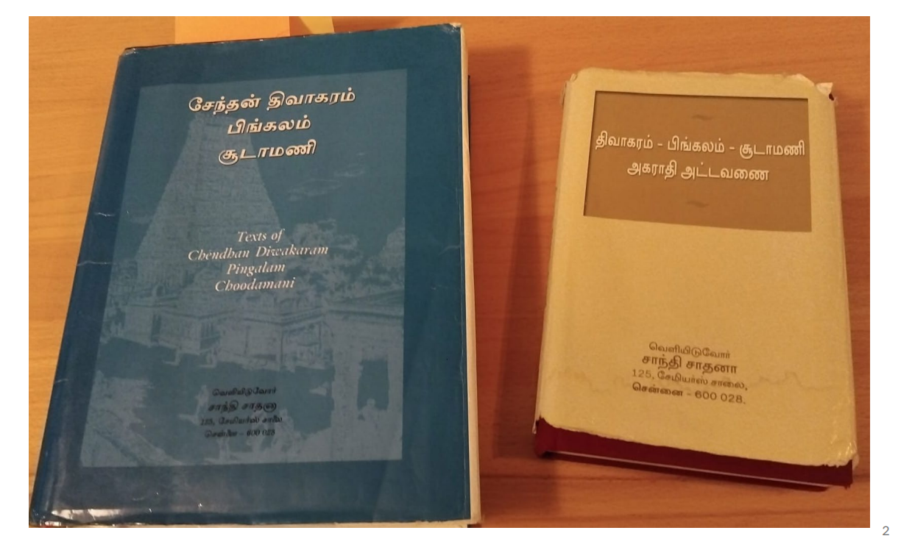
How to locate „maṉ“ (in „maṉṉuyir“) inside Tivākaram?

Slide 22
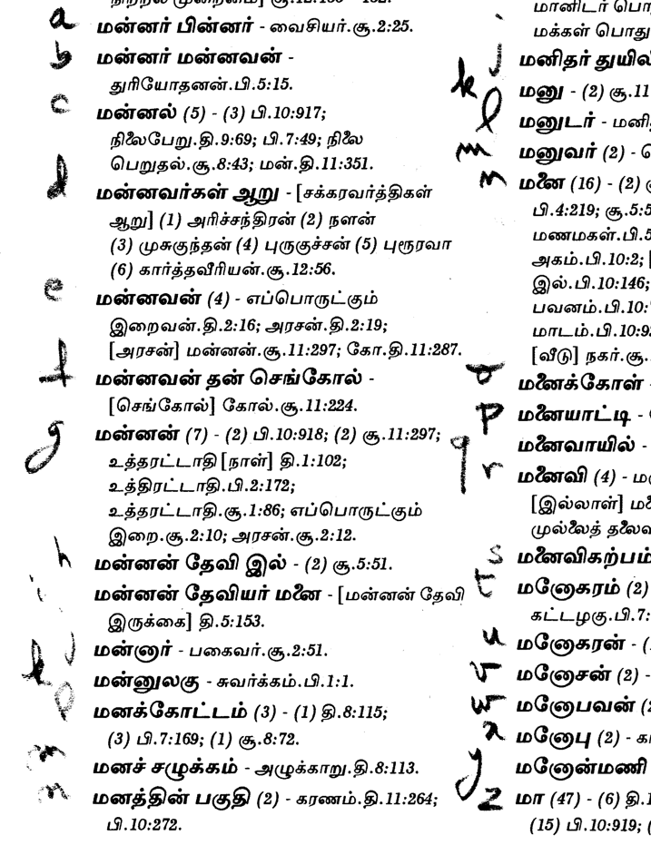
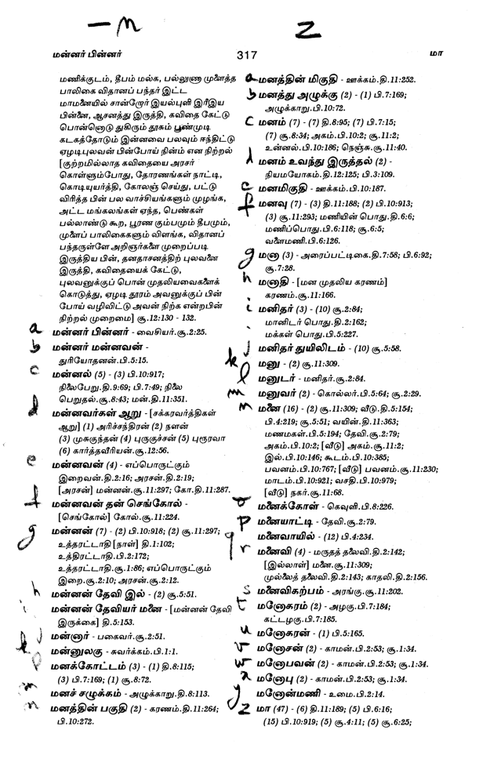
How to locate „maṉ“ (in „maṉṉuyir“) inside Tivākaram?

Slide 23
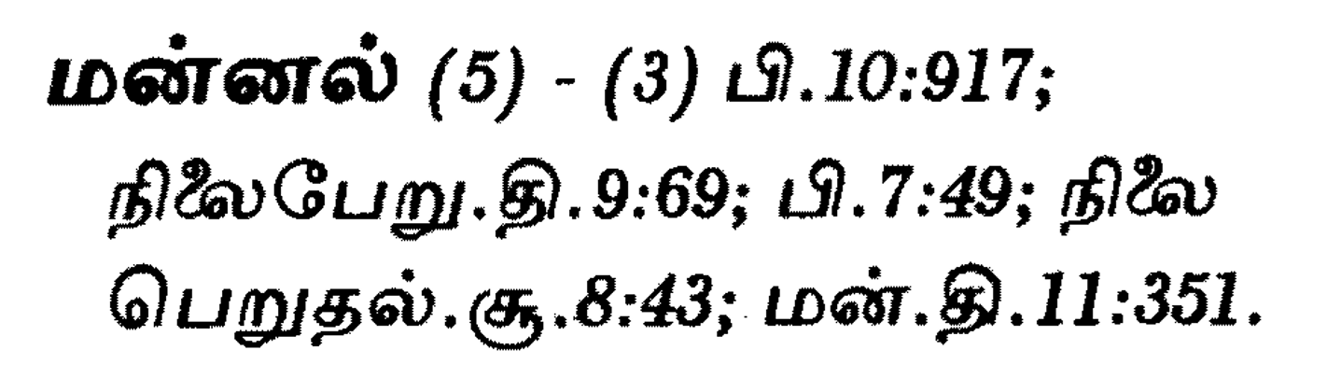
How to locate „maṉ“ (in „maṉṉuyir“) inside Tivākaram?

Slide 24
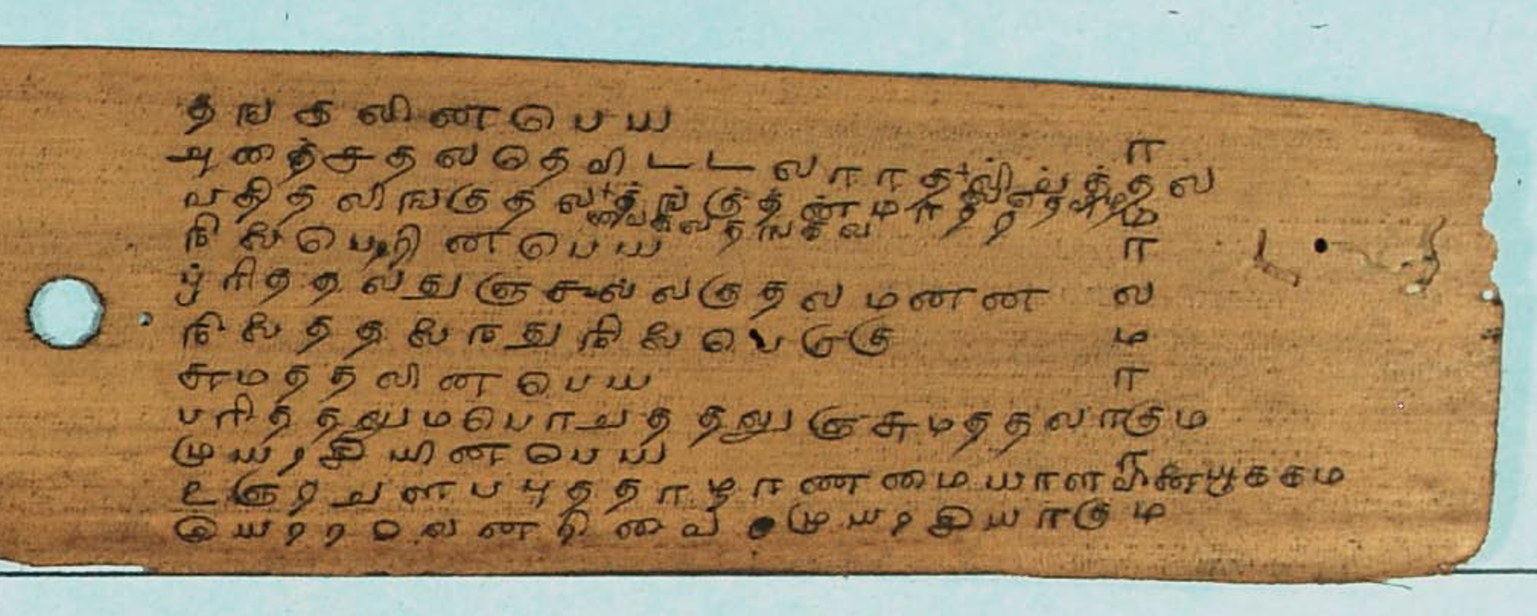
How to locate „maṉ“ (in „maṉṉuyir“) inside Tivākaram? (IFP ms, RE47779)

Slide 25
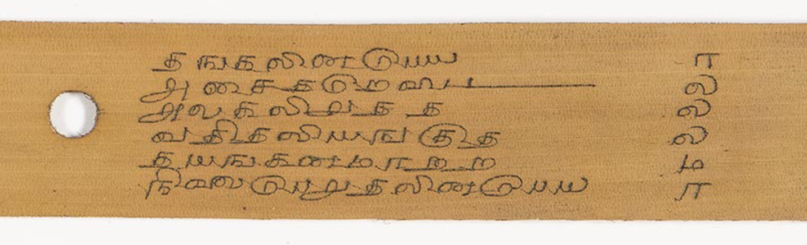
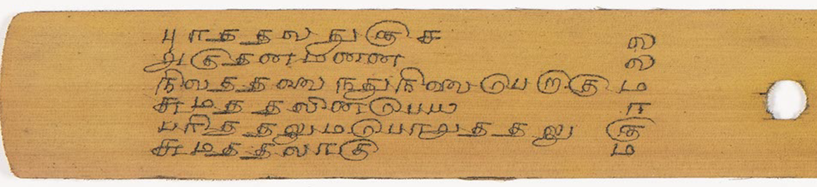
How to locate „maṉ“ (in „maṉṉuyir“) inside Tivākaram? (BnF, indien 239, p.239 & p.240)

Slide 26
Maṉṉal: Ti-9_69
நிலைபேற்றின் பெயர் (Sūtra 1613) ((Chap. 9))
புரத்தல், துஞ்சல், அல்குதல், மன்னல்,
நிலைத்தல் ஐந்தும் நிலைபேறு ஆகும்.

Slide 27
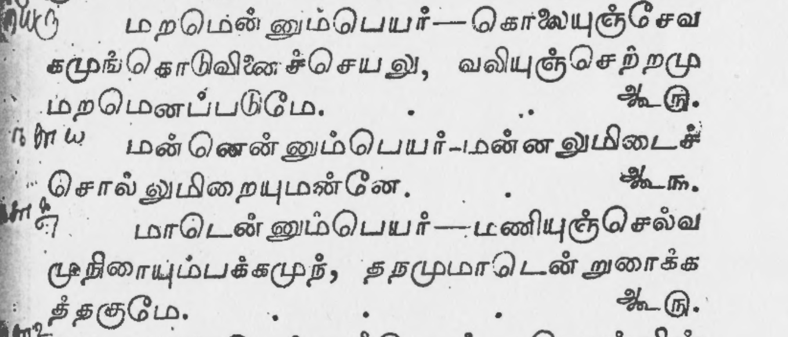
maṉṉal as 1 of 3 values of Polysemic maṉ: Ti-11_351 Editio Princeps 1840

Slide 28
Maṉṉal: Ti-11_351
மன் என்னும் பெயர் (Sūtra 2233)
மன்னலும், இடைச்சொலும் இறையும் மன்னே.

Slide 29
The beginning the Printing of Tivākaram in 1839 and 1840 (Tāṇṭavarāya Mutaliyār)
Link towards a blog entry on the Tamilex Blog
https://tamilex.hypotheses.org/278 «New old *words for Classical Tamil: Elements of information concerning the early print history of the Tivākaram, first Classical Tamil poetical vocabulary, in comparison with some MSS evidence»

Slide 30
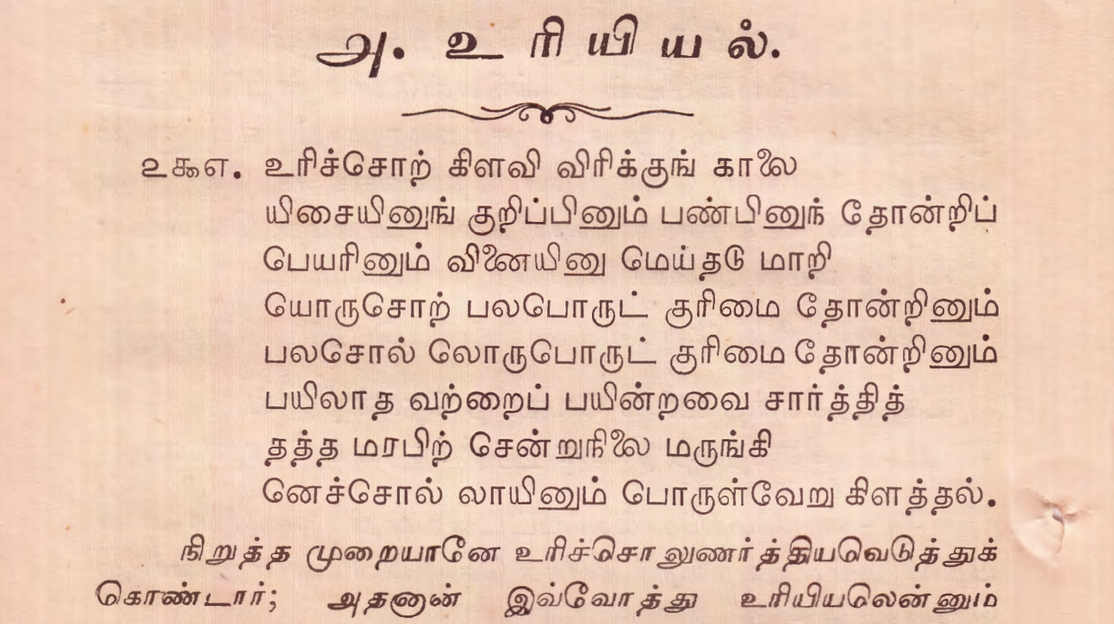
Uriccol, as characterized in Tolkāppiyam

