Slide 1


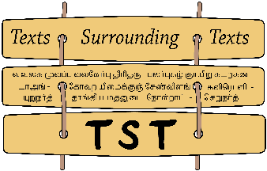


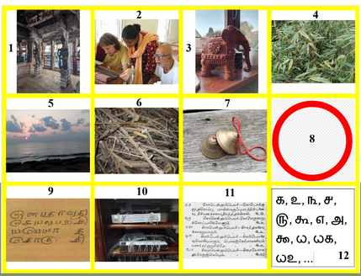
How to Make Good Use of an Ancient Tamil
Poetic Vocabulary while Preparing a Dictionary of Classical Tamil
Tamilex
Eva Wilden, Hamburg
Séminaire Mondes Indiens, 3 December 2026

Slide 2
The Micro-structure: chapter 4 – Plants marappeyart tokuti, “Collection of Tree Names“
Ch. 4
sutra 628-844
= 217 head words
225 h.w. (1 missing)
216 items (2 missing)
208 h.w. (10 missing)
critical edition:
Tivākaram. Mu. Caṇmukam Piḷḷai & I. Cuntaramūrtti (eds),
vol. 1, Ceṉṉai Palkalaik Kaḻakam, 1990
manuscripts:
C1 (UVSL 449) 61 f., complete, titles: f. 316r
P1 (BnF INDIEN_239) 161 f., complete (Ducler), no titles: f. 54r
P4 (BnF INDIEN_575) chapter 4 {uninked, not fully digitised}
T5 (TU_Tamil-0625-0811) 62 f., chapter 1-8 + titles: im. 64

Slide 3
Table of Contents (not marked in any way)
Trees (maram)
Ferns(?) (pul)
general terms for trees (parts and accumulations)
garden plants (decorative and edible/usable)
creepers and flowers
general terms for flowers
colophon
with some interruptions,
such as
c.e.: 719. īṅkaiyiṉ peyar, “Names for mimosa”
iṇṭai ~īṅkai in section 3

Slide 4
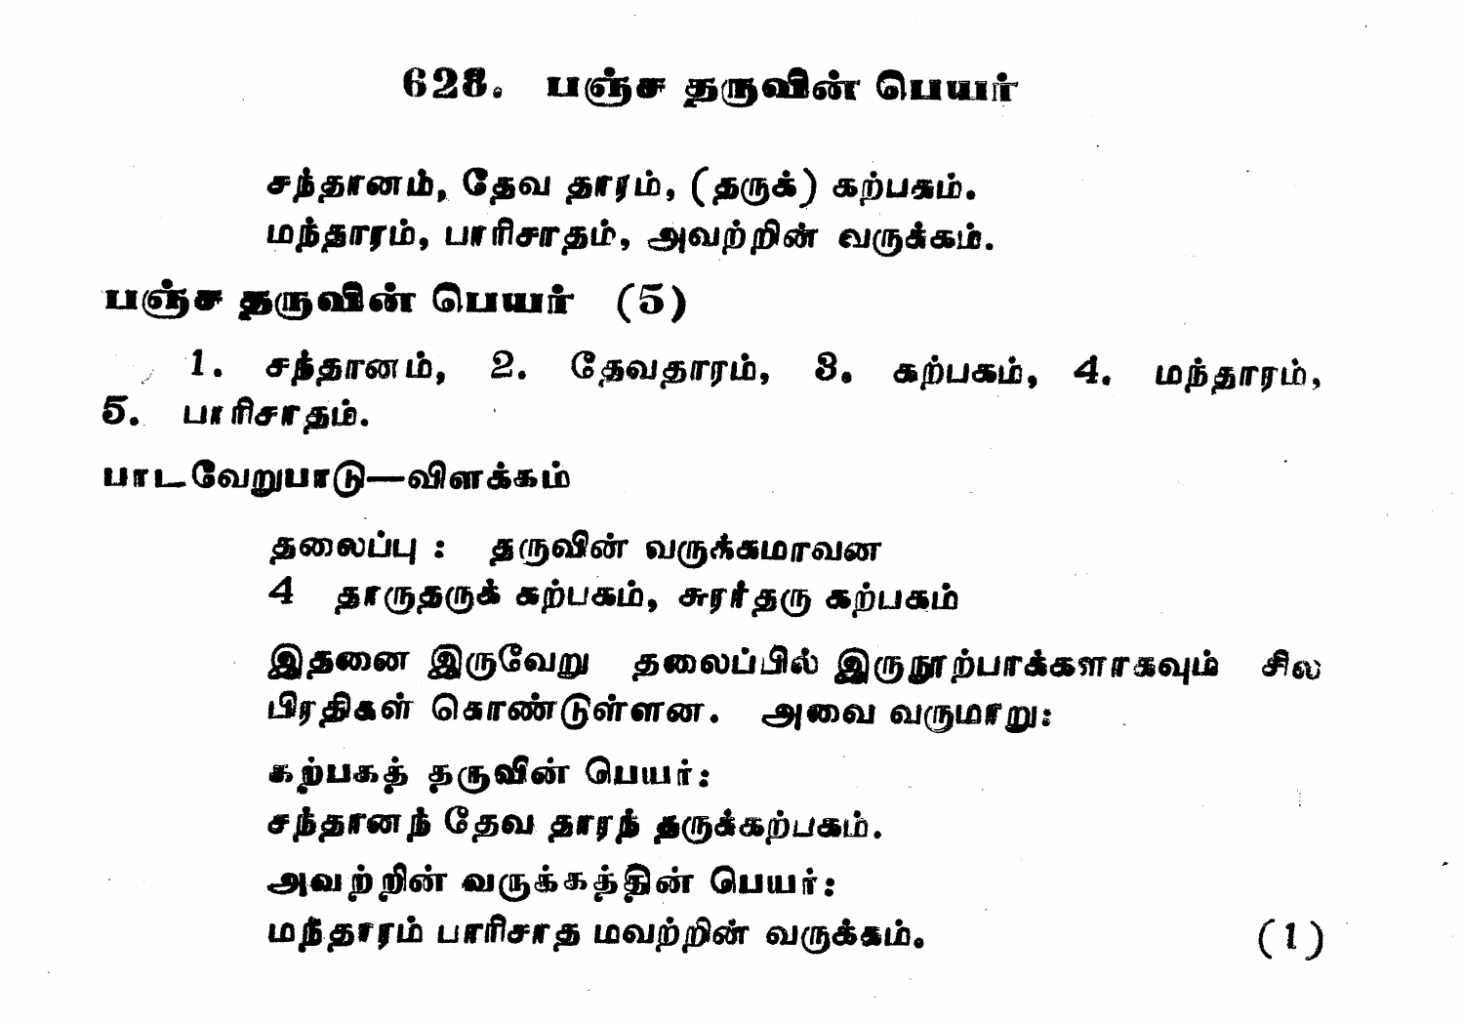
An entry in the “critical edition“
unified title = headword
semi-wordsplit sutra
enumeration of synonyms
apparatus with variant
but without source
indication
notes

Slide 5
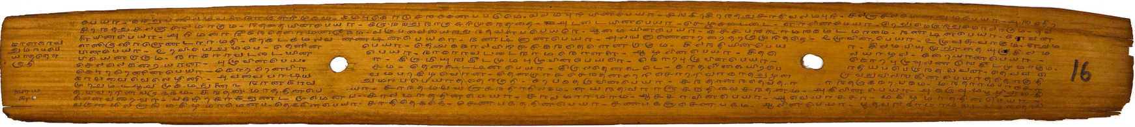
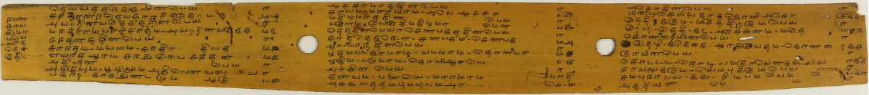
The three manuscripts
UVSL 449: Tivākaram, ch. 4 – scriptio continua, but lines separated by hyphen, titles count as lines
TT Tamil_0625_0811: Tivākaram, ch. 4 – columns with titles and numbers
BnF INDIEN_239: Tivākaram, ch. 4 – columns, text only

Slide 6
Titles – a Minimal Commentary
standard cases:
638. acōkiṉ peyar
piṇṭi ceyalai kākōḷi ~acōk*-ē
“Piṇṭi, Ceyal, Kākōḷi [are words for] the Aśoka tree.
645. attiyiṉ peyar
atav*-um utumparam-um atti ~ākum
“Atavu and Utumparam will be Atti.“
649. ceruntiyiṉ peyar
pañcaram ceṅkōṭu cerunti ~eṉa+ pakarvar
“The call the Cerunti Pañcaram [and] Ceṅkōṭu.
minimal sutra
635. ceṇpakattiṉ peyar
caṇpakam ceṇpakam
“Caṇpakam [is] Ceṇpakam.“
but: on 217 head words in the edition come 156 title deviations!

Slide 7
Titles -- Different Head Words
different names:
c.e.: 628. pañca taruviṉ peyar
C1: kaṟpaka taruviṉ peyar
T5: 1. teyvattarukkaḷiṉ peyar
different head word:
c.e.: 631. marāmarattiṉ peyar
C1: cālamarattiṉ peyar
sutra: cālam marāmaram
different organisation:
c.e: 643. nāvaliṉ peyar
campu nāval
644. vēmpiṉ peyar
nimpam vēmp*-ē
T5: nāvalukkum vēmpukkum peyar
campu nāval -16- nimpam vēmp*-ē -17-
variations on the spelling of the name:
c.e.: 642. kurāviṉ peyar
C1: kuṭaviṉ peyar
T5: 15. kuraviṉ peyar

Slide 8
Titles: Different Levels of Abstraction
c.e.: 727. ciṟutūṟṟiṉ peyar “little bushes”
T5: 95. ciṟuceṭikaḷ[u]kku potuppeyar >> type, not species!
aril-ē patukkai ciṟutūṟ* ākum
c.e. 698. āṇmarattiṉ peyar >> species(?)
C1: orupeyar marattiṉ peyar >> extension sutra
T5: 68. orupeyaraiyuṭaiya maraṅkaḷiṉ peyar “trees with only one name”
ekiṉam cemmaram/cēmaram āṇmaram eṉpa
C1, T5: orumaram orupeyar uraikkum kiḷavi >> extra line

Slide 9
Additions and Substractions
extra sutras
extra lines
extra words >> metre
missing sutras
missing lines
missing words? >> hypometrical sutras?

Slide 10
The Sutra Missing in the Three Manuscripts
717. orupeyar maravakaip peyar
oru maram oru peyar uraikkum kiḷavi
varaiv* il +eṉmaṉār vaḷḷiyōr-ē
“Words that denote one tree with one name
are without limits, say the liberal people.“
in the middle of the
section on general
words for tree!
C2 [72.] (698) orupeyar marattiṉ peyar
ekiṉam cēmaram āṇmaram eṉpa
orumaram orupeyar uraikkum kiḷavi
“Ekiṉam, Cēmaram [and] Āṇmaram, they say,
are words which denote one tree with one name.“
ends the section on trees!

Slide 11
Metre
T5: 193. (827) ceṅkuvaḷaiyiṉ peyar, “Names for red waterlilies”
ceṅkuvaḷai arattam uṟpalam ceṅkaḻunīr
normal nūṟpā
c.e.: 704. karumpiṉ peyar, “Names for sugarcane”
kaḻai vēḻam ikku kaṉṉal karump*-ē
metrical split:
kaḻaivēḻa mikku kaṉṉal karumpē >> extra name
Glitches:
hypermetrical feet
812. veṟṟilaiyiṉ peyar, “Names for betel”
nākavalli tāmpūlam veṟṟilai >> overlong names

Slide 12
Hypermetrical Sutras -- Glitch?
c.e.: 628. pañca taruviṉ peyar, “Names of the five trees”
C1: [1.] kaṟpaka taruviṉ peyar, “Names of the wish-fulling trees”
T5: 1. teyvattarukkaḷiṉ peyar, “Names of the divine trees”
cantāṉam tēvatāram taru+ kaṟpakam
mantāram pāricātam avaṟṟiṉ varukkam
“The Cantāṉam, the Tēvatāram tree, the Kaṟpakam,
the Mantāram, [and] the Pāricātam [are] their kinds.
Metrical split needed for the first line:
cantā ṉamtēva tāramtaru+(h) kaṟpakam >> unnatural split and still
mantāram(h) pāricātam(h) avaṟṟiṉ varukkam three hypermetrical feet!

Slide 13
Distribution of Languages
old share – seminated by Tolkāppiyam
equitable distribution of Tamil and Sanskrit(/Prakrit)
dominated by Sanskrit >> added late(r)?

Slide 14
Pure Tamil sutras on the Difference between pul and maram
Tolkāppiyam Poruḷatikāram, Marapiyal: pul and maram
86. (TPi 630) puṟa+ kāḻaṉa-~ē pul eṉa moḻipa.
“Those that have their hard part outside [are] pul, they say.”
87. (TPi 631) aka+ kāḻaṉa-~ē maram eṉa moḻipa.
“Those that have their hard part inside [are] maram, they say.”
c.e.(!): 724. uḷvayira marattiṉ peyar
aka+ kāḻaṉa-~ē val maram ākum
avai-~ē karuṅkāli mutalā ~uḷḷaṉa
“Those that have their hard part inside are hard trees.
Those include Karuṅkāli as the first.”
c.e.725. puṟavayira marattiṉ peyar
puṟa kāḻaṉa-~ē val pul +eṉpa
avai tām terikkiṉ paṉai teṅku kamuku mūṅkil
“Those that have their hard part outside are hard grass.
Those are, if made evident, [are] palmyra, coconut, areca nut [and] bamboo.”
The growth of a sutra:
3. title (Skt. word – fashionable?)
1. old core taken from Tolkāppiyam
2. examples integrated

Slide 15
Roughly Equal Distribution of Tamil and Sanskrit
c.e.: 713. kāṭṭiṉ peyar, “wild forest”
kaṭam (viyal) paḻuvam kaṭci kuṟumpoṟai
kaṭaṟu kāntāram aṭavi kāṉ vaṉam
kavaṉam kāṇṭam (kaṉam) muḷari
curam attam āraṇiyam kāṉam kaḷari
(cīr aṇi) poccai viṭar tillam kāṭ*-ē
Skt. words:
kakṣa-
kāntāra-, aṭavi-, vana-
gahana-, kāṇḍa-?
advan-, araṇya-, kānana-?
781. eḷḷiṉ peyar, “sesamum”
eṇ-+um tilam-um eḷ +eṉa ~icaippar
<Skt. tila-

Slide 16
Domination of Sanskrit: 21 Words for ‘Lotus’
c.e. 825: tāmaraiyiṉ peyar
puṇṭarīkam, naḷiṉam, patumam, carōrukam,
muṇṭakam, ampōrukam, aravintam,
paṅkayam, ampucam, vārīcam, calacam,
kañcam, vaṉacam, kōkaṉakam, kamalam,
ampuyam, muḷari, tirumāl koppūḻ,
tirumalar, iṇṭai, catapattiri (eṉa)
(varupavai) tāmarai (vaḷ peyar ākum).
Tamil
Tēvāram
Tivyappirapantam
old corpus:
muṇṭakam, a thorny bush
muḷari, thorn twig
iṇṭai, Tēvāram: circlet of flowers
> on 21 items 18 Sanskrit words and calques

Slide 17
Conclusions
Clear sub-structure (with few interruptions)
Titles function in lieu of a commentary
Considerable regional variation
Multiple indications of reworking (metrical anomalies)
Constant and growing influx of Sanskrit, probably over many centuries
A Critical edition will rather have to be a synoptic and cumulative effort:
  Marking the different titles and concomitant sutra splits
  Recording regional/dialectal/spelling variations and still weed out mis-spellings
  make the layers visible without destroying or streamlining them

Slide 18
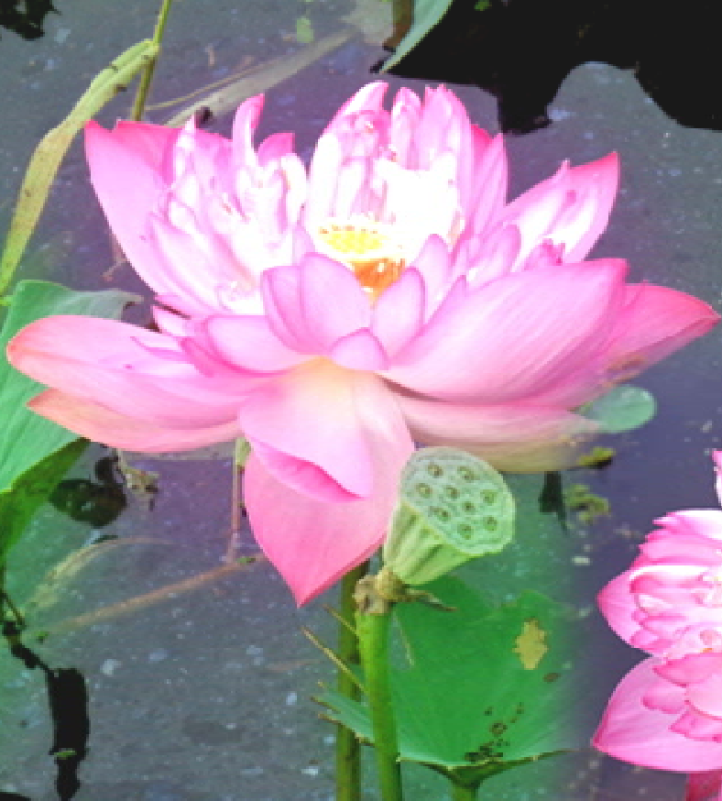
thank you!

