Slide 1
How Tamil poets faced the challenge of producing metrical lines with a fixed number of syllables
Jean-Luc CHEVILLARD (HTL & Tamilex)
SHESL-2026
22 January 2026

Slide 2
A tentative table of content
Identifying the type of a poem P1 quoted in TNV
Displaying verse YK34 from a metrical treatise (YK)
Showing the TOC of YK
Showing where YK34 is inside TOC
Showing how P1 fits in YK34 (type 3)
Showing the normal case (type 1)
Moving to the life of UVS
UVS learning YK in 1869 in his 14th year
What UVS had learnt before
Who UVS was and his family background
What UVS accomplished in his life
Global chronology for Tamil
What I cannot talk about

Slide 3
A poem quoted in TNV used as a starting point
இனையல் வாழி யெம்மூர் மலர்ந்த
பழனத் தாமரைக் கெழீஇய வண்டுநின்
கண்ணென மலர்ந்த காமர் சுனைமலர்
நண்ணி நாளு நலனுக ரும்மே
iṉaiyal vāḻi yemmūr malarnta
paḻaṉat tāmaraik keḻīiya vaṇṭuniṉ
kaṇṇeṉa malarnta kāmar cuṉaimalar
naṇṇi nāḷu nalaṉuka rummē
Notes:
A Ph.D. student in Hamburg recently asked me how to characterize a poem which was quoted in the commentary to the poetological treatise (தமிழ் நெறி விளக்கம்) on which he is finishing to write his thesis. The question asked had to do with the count of cīr-s “feet” on the lines

Slide 4
A grammatical verse from YK answering the question
கடையயற் பாதமுச் சீர்வரி னேரிசை காமருசீர்
இடைபல குன்றின் இணைக்குற ளெல்லா அடியுமொத்து
நடைபெறு மாயி னிலைமண் டிலநடு வாதியந்தத்
தடைதரு பாதத் தகவல் அடிமறி மண்டிலமே
kaṭaiyayaṟ pātamuc cīrvari ṉēricai kāmarucīr
iṭaipala kuṉṟiṉ iṇaikkuṟa ḷellā aṭiyumottu
naṭaipeṟu māyi ṉilaimaṇ ṭilanaṭu vātiyantat
taṭaitaru pātat takaval aṭimaṟi maṇṭilamē (YK34)
Notes:
I answered to him that the answer can be found, from the point of view of Tamil traditional scholars, inside a verse of the kārikai type, which belongs to a text called YK (யாப்பருங்கலக்காரிகை). That verse reads as shown here COMMENT ON THE FACT THAT THERE ARE 5 FEET and 17 eḻuttu-s.

Slide 5
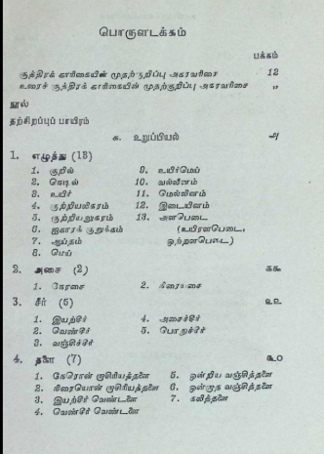
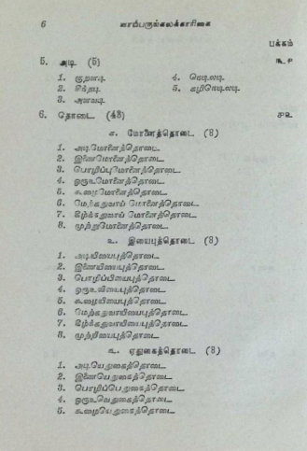
Table of content of YK

Slide 6
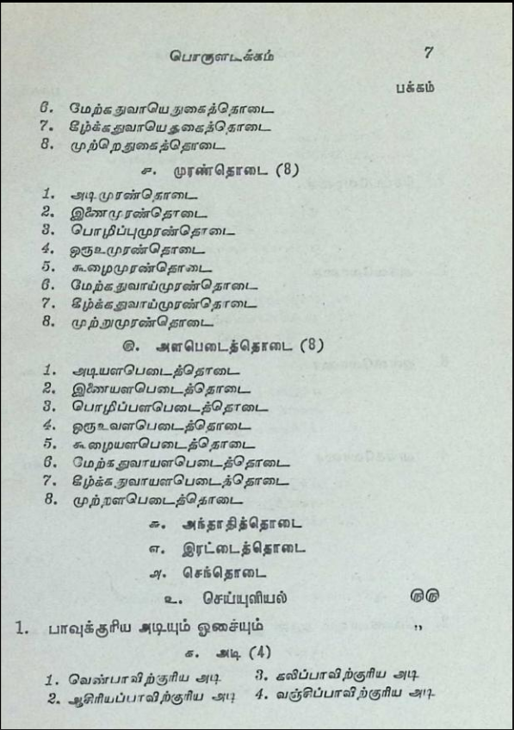
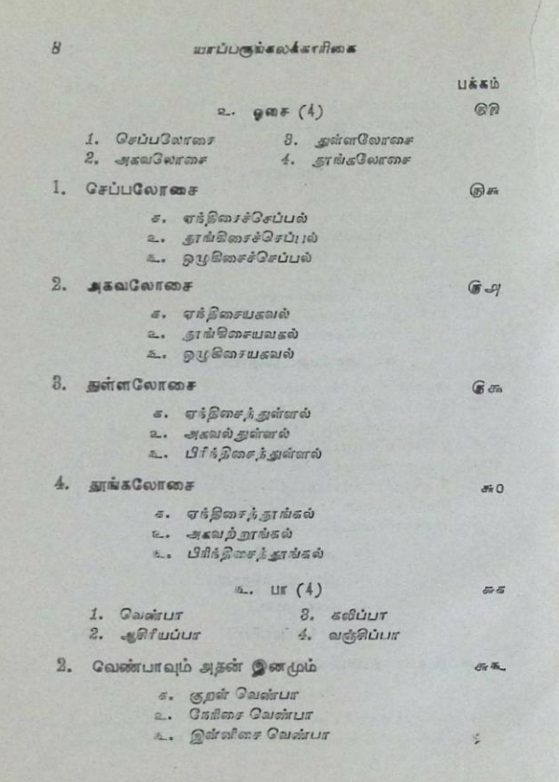
Table of content of YK

Slide 7
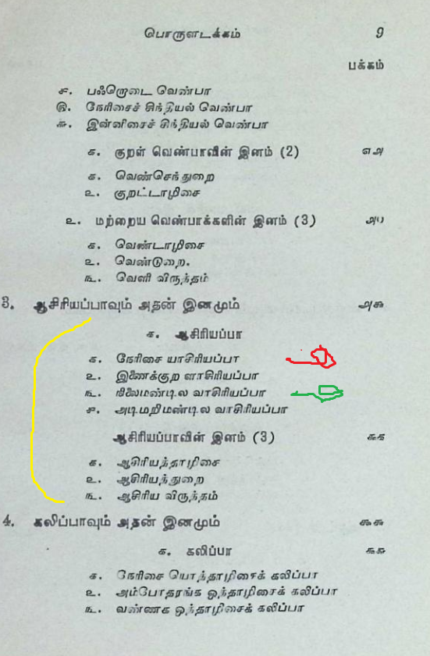
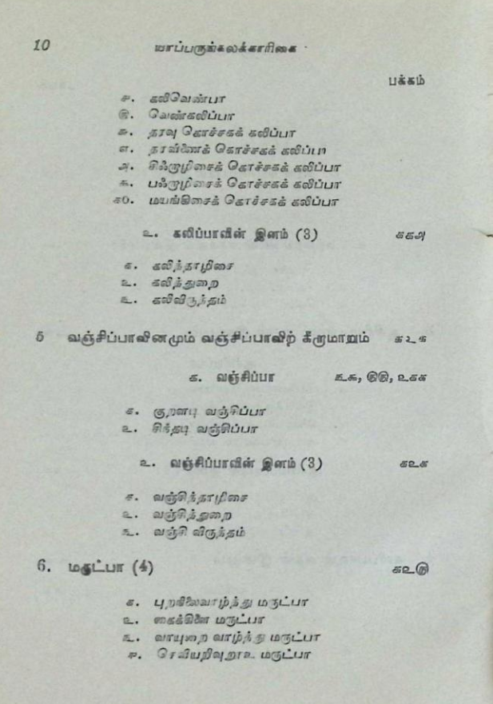
Table of content of YK

Slide 8
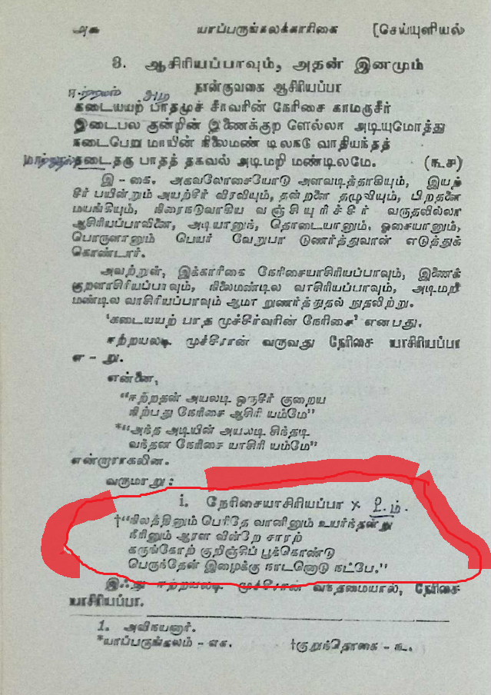
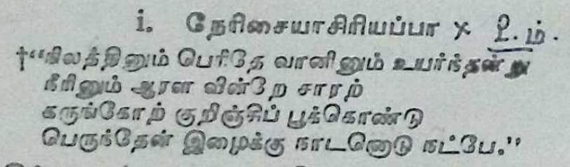
YK, with commentary and KT3 as example for type 1

Slide 9
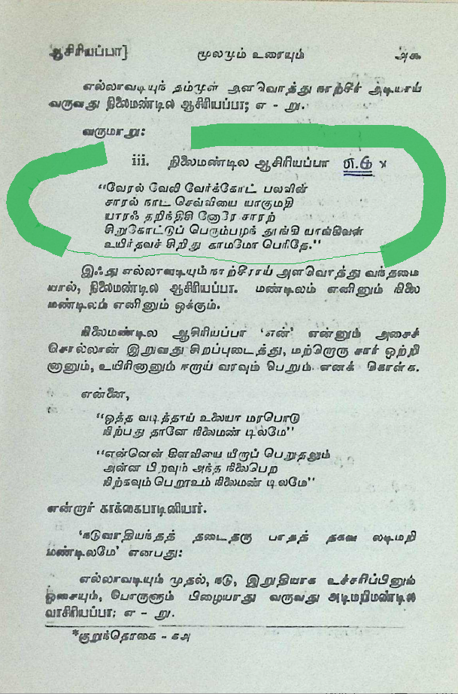
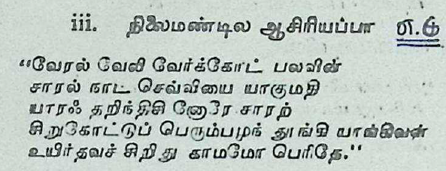
YK, with commentary and KT18 as example for type 3

Slide 10
What is Classical Tamil?
A poetical language which differs very much from every-day Tamil and which is really mastered only by a few people after a long effort.
A minority of Tamil speakers, who are „triglossic“ as a result of a long training, serve as living bridges, who preserve the ritual connection between Modern Tamil speakers and the ancient Tamil linguistic heritage, of which the most accessible jewels are the famous Kuṟaḷ (a lay text) and the devotional corpus, of which the most well known parts are the Tēvāram and the Tiruvācakam (for the shaivas) and the Nālāyira Tivviya Pirapantam (for the vaiṣṇavas).
The most ancient part of the classical corpus, which consists of the Eight anthologies, the Teng long Poems and the Tolkāppiyam is however extremely difficult of access. One should also mention the existence of ancient poetical vocabularies, starting with the Tivākaram.

Slide 11
A poetical language which differs very much from every-day Tamil and which is really mastered only by a few people after a long effort (outsiders testimony)
Quote Beschi‘s prefaces: -- to Tamil-Latin (Latin vs. Portuguese) -- to Caturakarāti : „all the sciences“ Quote Ziegenbalg, referring to Tivākaram „the common malabarian“ do not understand a word of it, of very little“

Slide 12
A poetical language which differs very much from every-day Tamil and which is really mastered only by a few people after a long effort (insiders testimony)
Give extracts from UVS‘s autobiography, showing how he learnt as a child: page 103: sowing the seeds of Tamil (Music-with-the-help-of-Tamil → Tamil-with-the-help-of-music)
Caṭakōpaiyaṅkār: பரம்பரையாக வித்துவான்களாக இருந்தோர் மரபிற் பிறந்தவர்

Slide 13
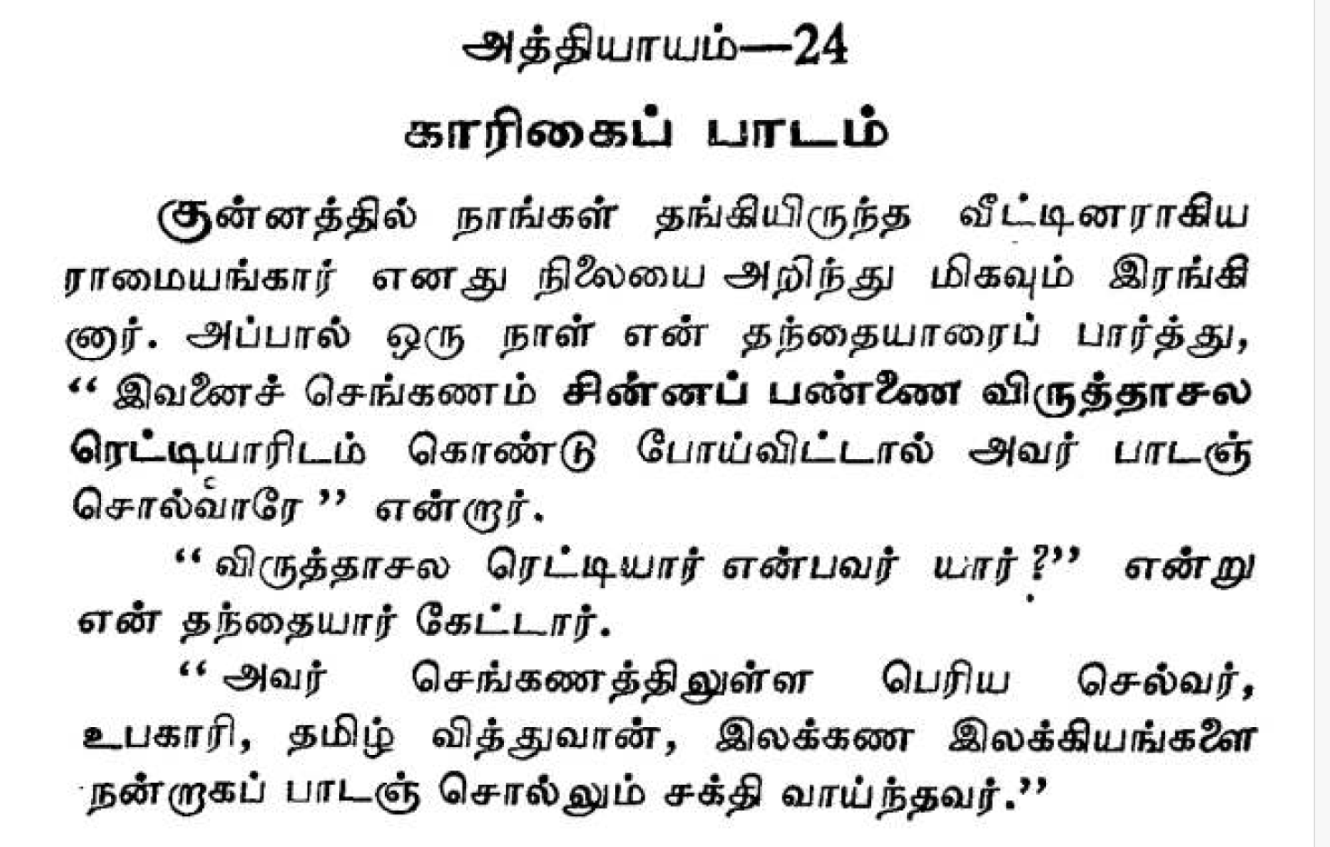
Visiting the life of a few traditional scholars, through the autobiography of UVS (1855-1942)

Slide 14
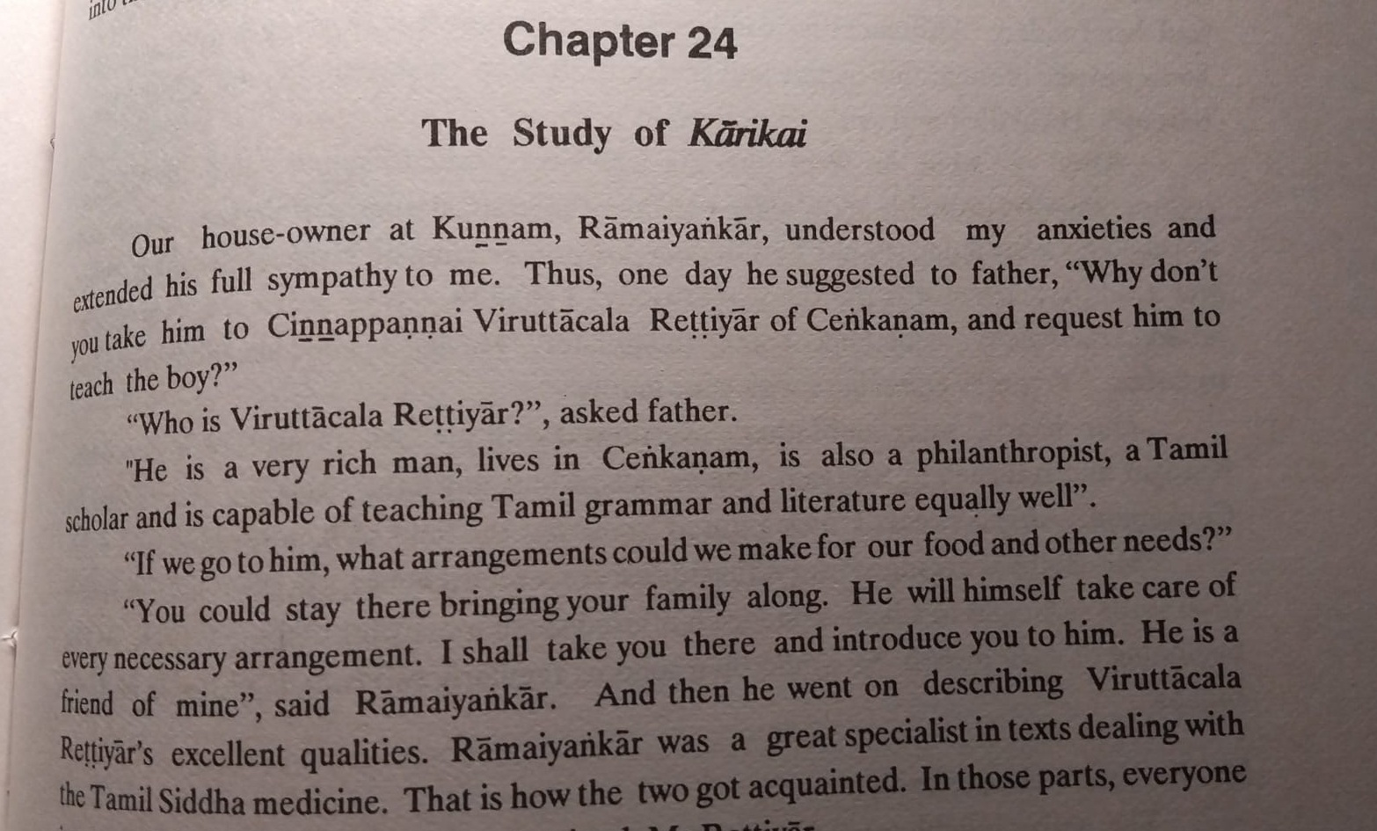
Visiting the life of a few traditional scholars, through the autobiography of UVS (1855-1942)

Slide 15
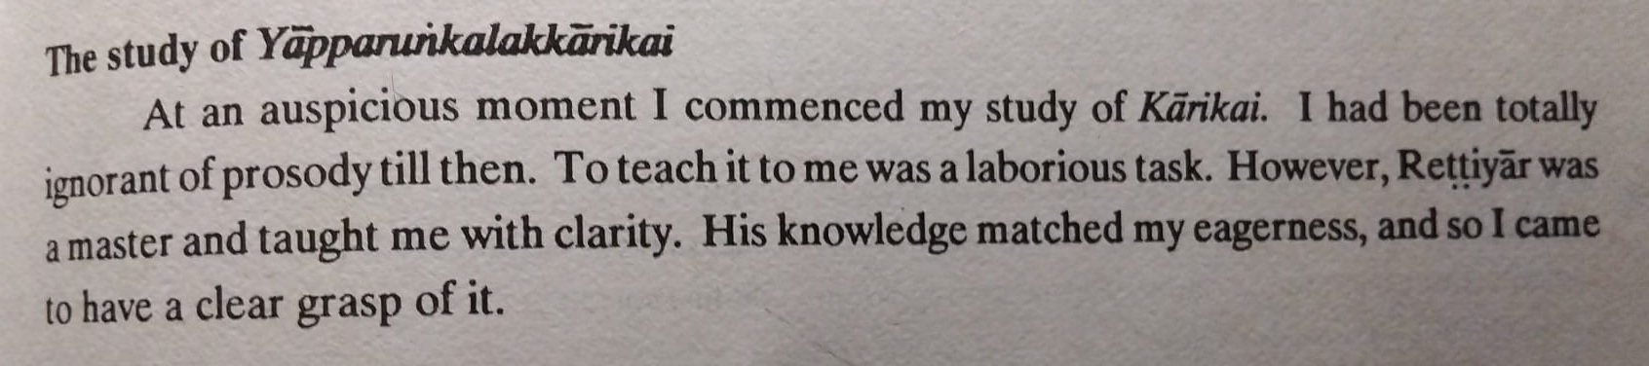
Visiting the life of a few traditional scholars, through the autobiography of UVS (1855-1942)

Slide 16
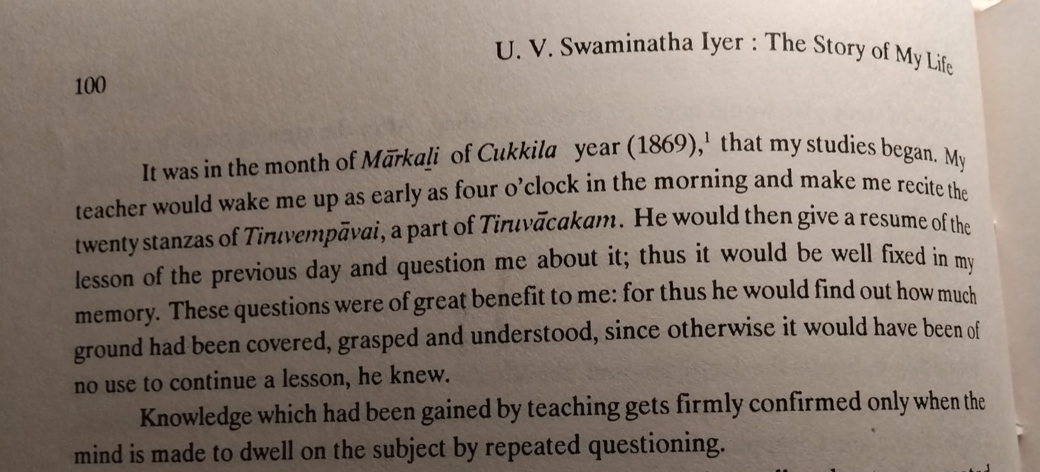
Visiting the life of a few traditional scholars, through the autobiography of UVS (1855-1942)

Slide 17
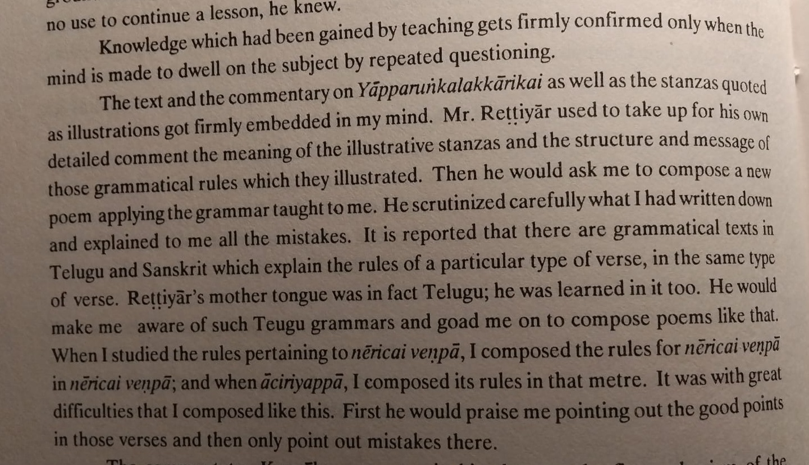
Visiting the life of a few traditional scholars, through the autobiography of UVS (1855-1942)

Slide 18
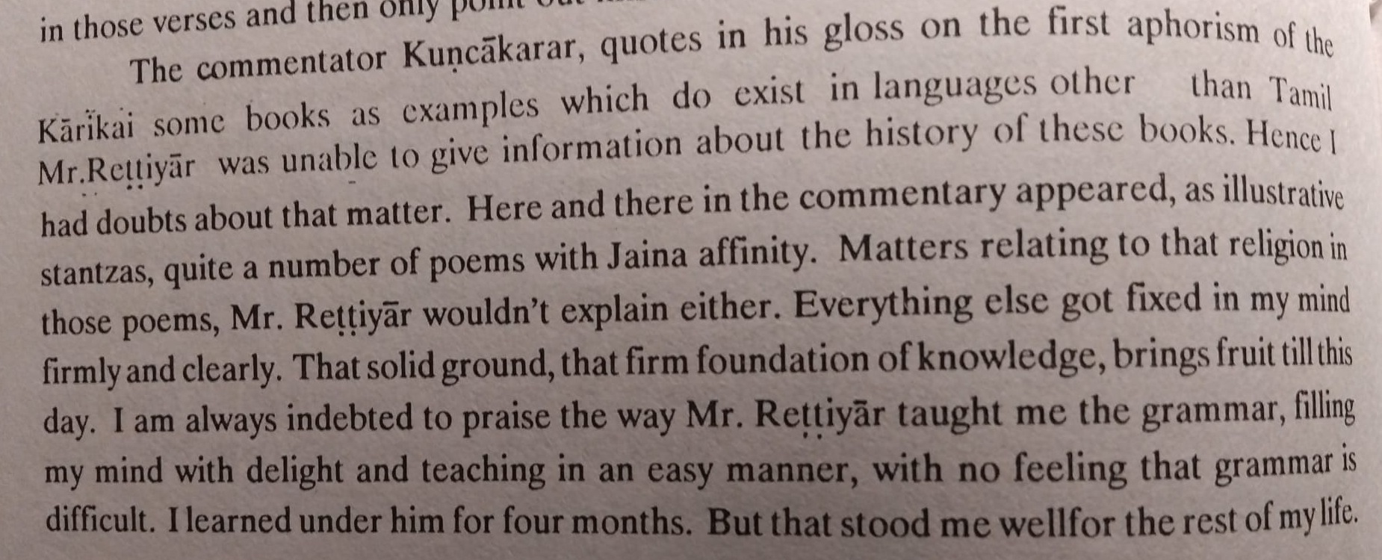
Visiting the life of a few traditional scholars, through the autobiography of UVS (1855-1942)

Slide 19
What I cannot talk about
What UVS had learnt before
Who UVS was and his family background
What UVS accomplished in his life
Global chronology for Tamil
My other articles on metrics (10 items)

Slide 20
Merci de votre attention
நன்றி
Naṉṟi

Slide 21
Abstract (1)
The importance of meter for memorization is generally not appreciated by the members of modern cultures in this world, because they take for granted the fact that someone else will take care of preserving the body of literature which is available on the shelves of our libraries, be they physical or be they virtual. Such was not the case in the ancient cultures of India, as is evidenced by the fact that one of the constituents of their grammatical rainbow was metrics

Slide 22
Abstract (2)
This is seen for instance with the importance of the discipline called chandas inside Sanskrit technical literature from the vedic time onwards. This is also seen in the case of Classical Tamil technical literature where the domain labelled as Ceyyuḷ or Yāppu has seen the successive compositions of a number of treatises, which were trying to keep up with the inventivity of Tamil poets.

Slide 23
Abstract (3)
The contribution proposed here will examine several of the attempts made by Tamil poets and captured by Tamil theoreticians at devising strategies capable of producing stanzas with metrical lines containing a fixed number of syllables, although such stanzas do not exist in the earliest Tamil poetical corpus, where what is seen is verses containing a fixed number of metrical feet. By doing that, they may have been emulating sanskrit poets, or they may have tried to compose poetry capable of being sung more easily, because it would fit with a preexisting melody.

