Slide 1
La trace de Jean Filliozat (1906-1982) dans l'histoire des études tamoules, 55 ans après la 3ème conférence IATR de 1970 au Collège de France (Paris)
Dr Jean-Luc CHEVILLARD
HTL (Paris) & Tamilex (Hamburg)
https://www.tamilex.uni-hamburg.de/team/chevillard.html

Slide 2
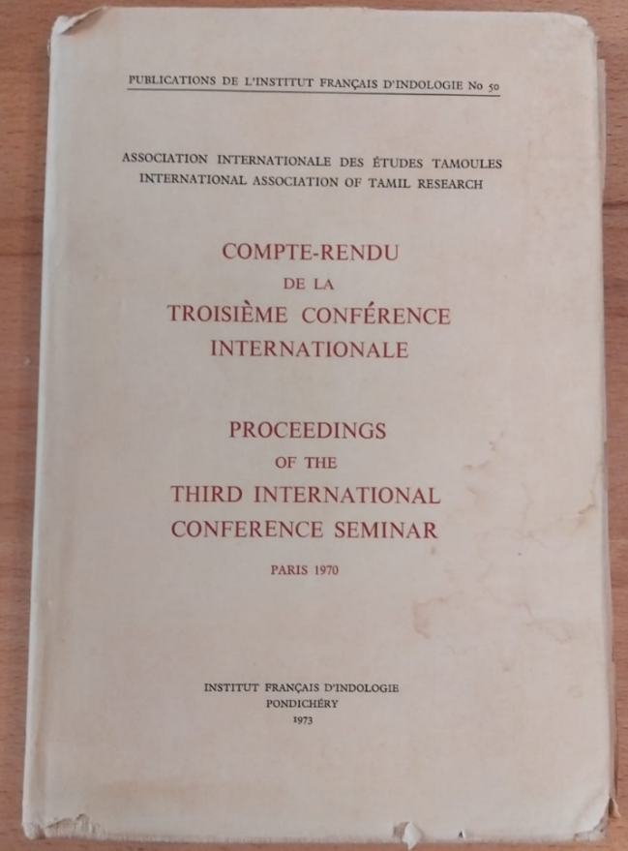
In 1973, the French Institute of Pondicherry, which was at the time called „Institut Français d‘Indologie“ published the 50th volume in its series of publications. The English title of that volume, comprising 279 pages, and edited by X.S. Thani Nayagam and François Gros, was „International Association of Tamil Research. Proceedings of the Third International Conference Seminar. Paris 1970“

Slide 3
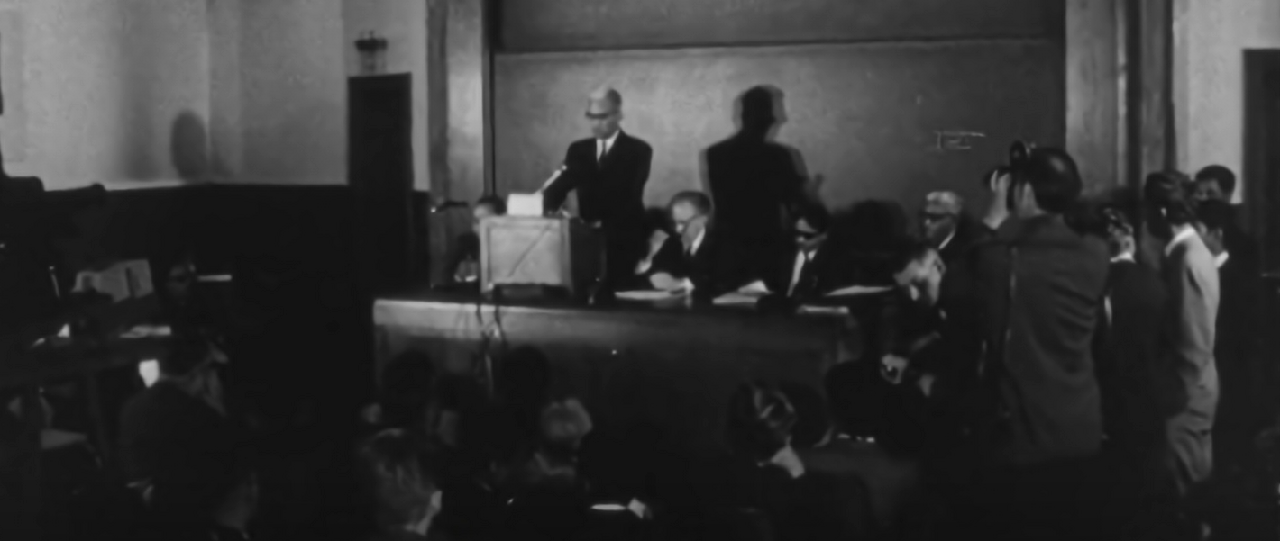
The 1970 Paris (third) IATR conference had been organized by Professor Jean Filliozat (1906-1982) and this presentation will revisit the carreer of that scholar, trying to derive inspiration from him, in a manner adapted to the modern world

Slide 4
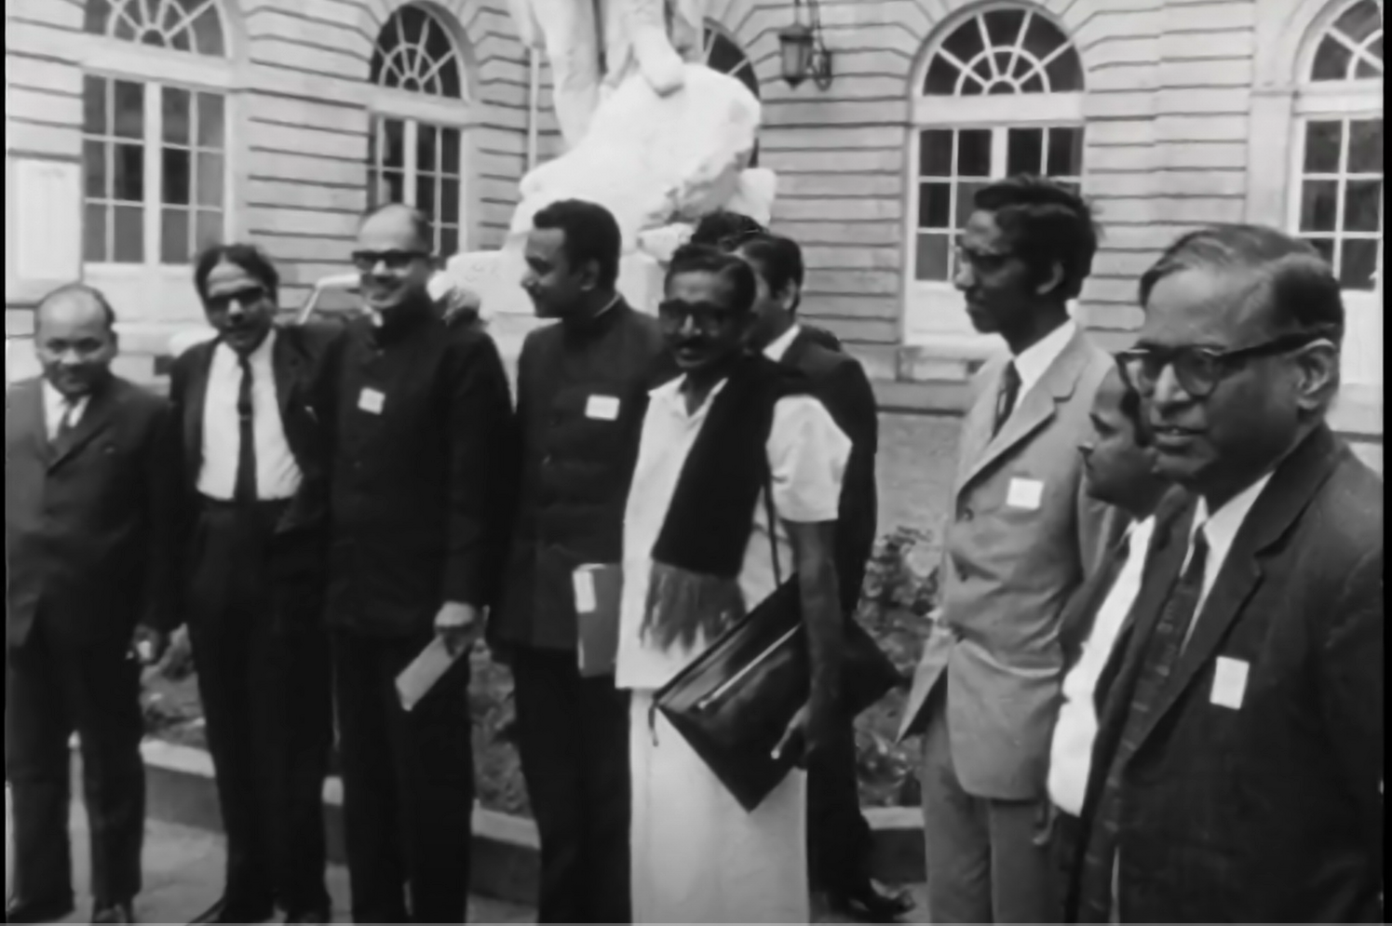
The 1970 Paris (third) IATR conference had been organized at the Collège de France (See indian delegation on this picture) by Professor Jean Filliozat (1906-1982) and this presentation will revisit the carreer of that scholar, trying to derive inspiration from him, in a manner adapted to the modern world

Slide 5
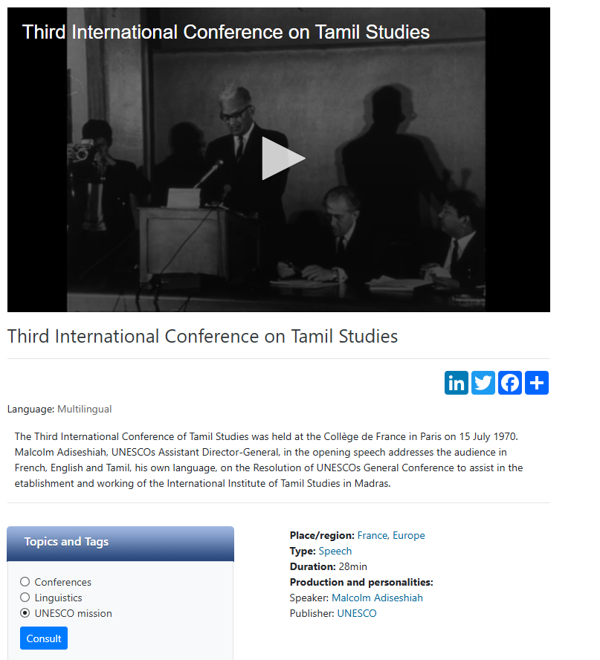
Link to a 28 min film made at the time of the 3rd IATR conference & available on the UNESCO web site:
The Third International Conference of Tamil Studies was held at the Collège de France in Paris on 15 July 1970. Malcolm Adiseshiah, UNESCOs Assistant Director-General, in the opening speech addresses the audience in French, English and Tamil, his own language, on the Resolution of UNESCOs General Conference to assist in the etablishment and working of the International Institute of Tamil Studies in Madras.
https://www.unesco.org/archives/multimedia/document-5085

Slide 6
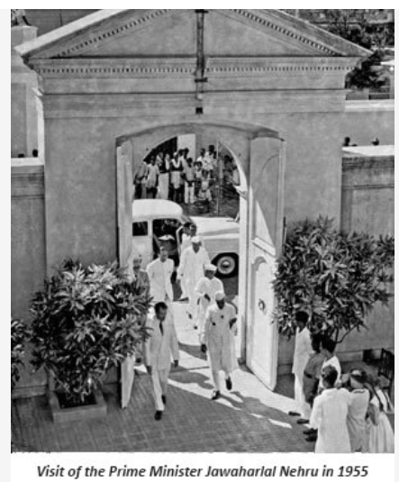
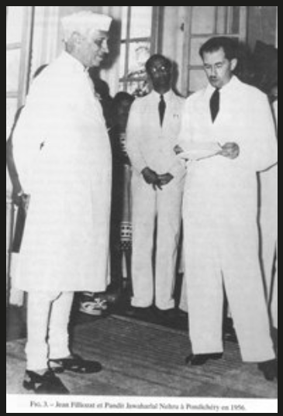
However, in order to understand who Professor Jean Filliozat (1906-1982) was, we have to move back in time, starting for instance with year 1955, when prime minister Jawaharlal Nehru visited the newly inaugurated Institut Français d‘Indologie, of which he was the first director

Slide 7
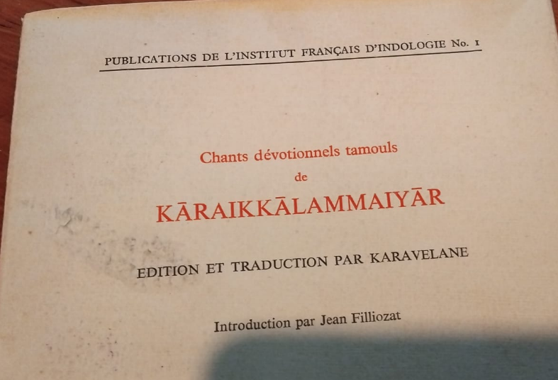
… and we might then move to the following year, namely 1956, when the FIRST publication of the IFP came out, which was an edition and translation of காரைக்கால் அம்மையார், by KARAVELANE, with an introduction by Jean Filliozat (a second edition came in 1982, with a postface by François Gros)

Slide 8
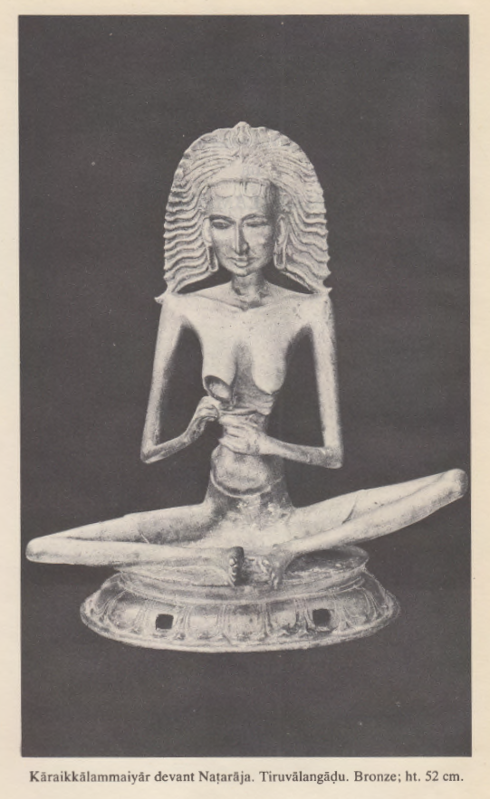
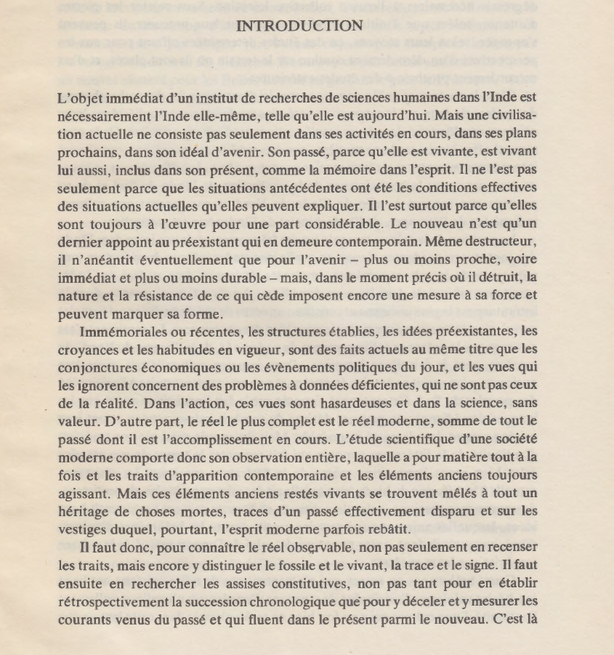

Slide 9
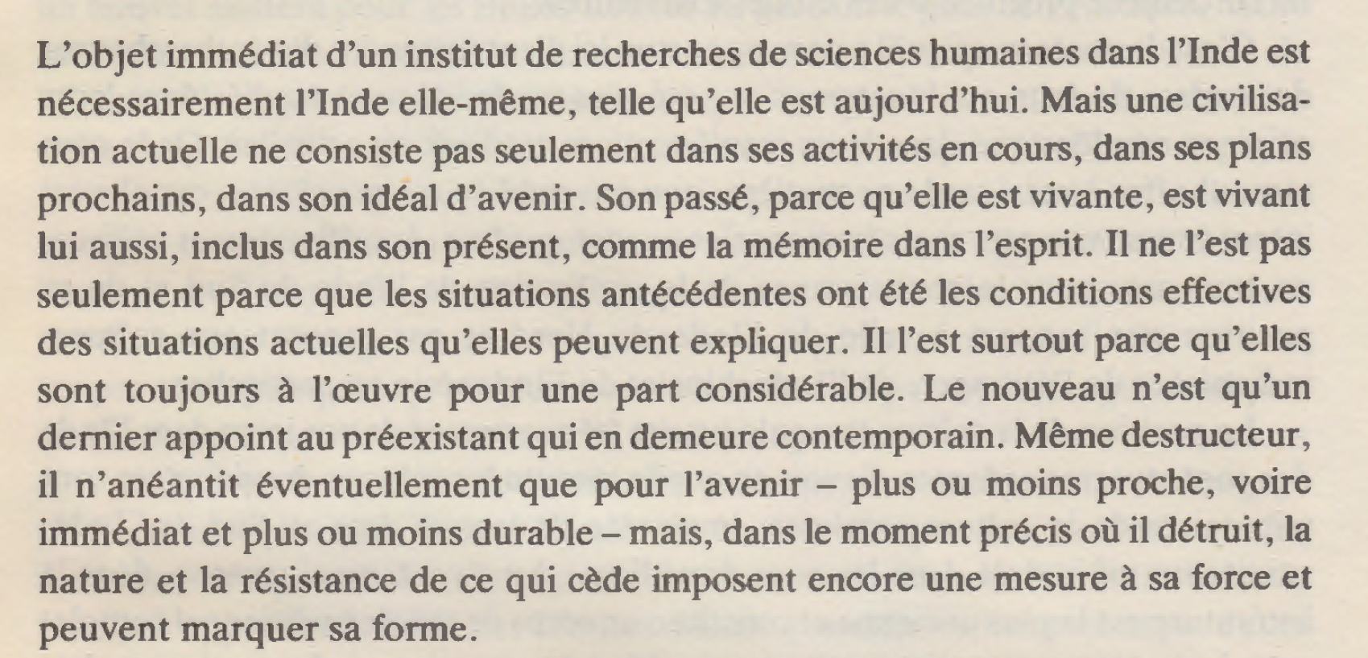

Slide 10
பிறந்து மொழிபயின்ற பின்னெல்லாங் காதல்
சிறந்துநின் சேவடியே சேர்ந்தேன் - நிறந்திகழும்
மைஞ்ஞான்ற கண்டத்து வானோர் பெருமானே
எஞ்ஞான்று தீர்ப்ப திடர். (Kāraikkāl Ammaiyār)
Le Poème de l‘admirable (அற்புதத் திருவந்தாதி)
« Depuis que, née, j‘ai appris à parler, débordant
d‘amour, j‘ai atteint tes pieds rouges. Magnanime Seigneur
des Célestes, à ta gorge resplendit une noirceur saillante.
Quand finiras-tu mes tourments? » (Karavelane, 1956)
(PIFI-1)

Slide 11
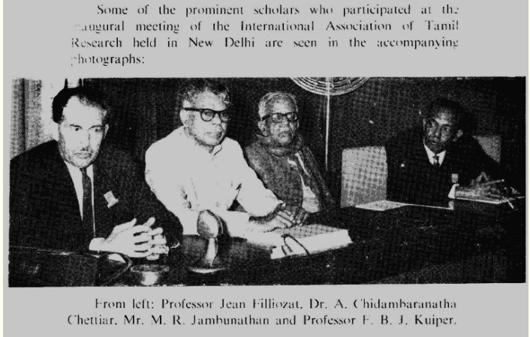
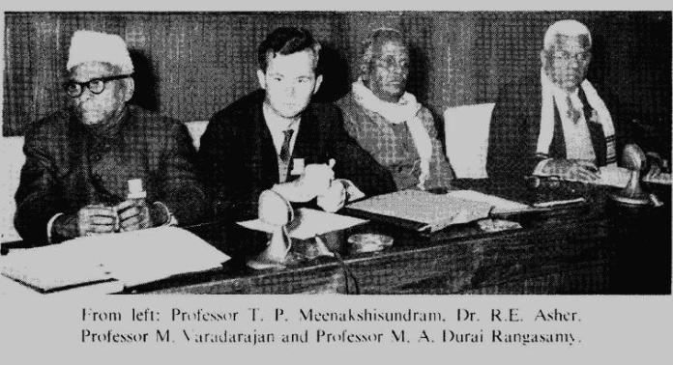
The birth of the IATR in New Delhi, on January 7, 1964 on the occasion of the XXVI International Congress of Orientalists

Slide 12
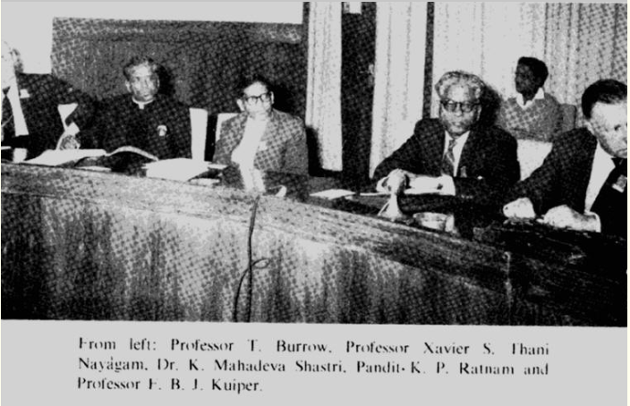
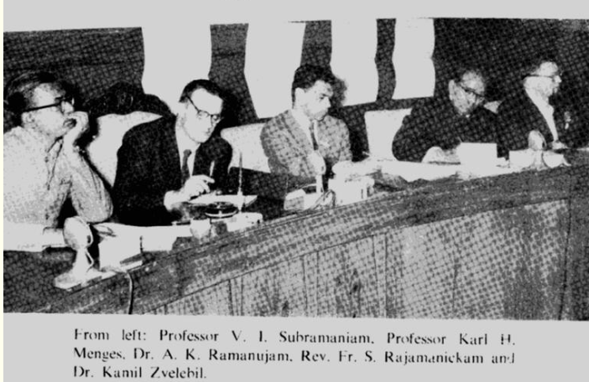
The birth of the IATR in New Delhi, on January 7, 1964 on the occasion of the XXVI International Congress of Orientalists

Slide 13
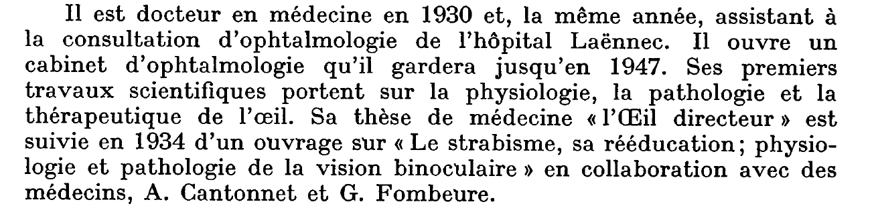
How did Jean Filliozat become a specialist of Tamil?
We know, through several sources, that Jean Filliozat, who was born in 1906, did not have the opportunity to go to India before 1947, when he had already studied the history, the civilisation and the literatures of India for many years. His original field of study was medecine, and he became „docteur en médecine“ in 1930, his special field of study being „ophtalmologie“
(SEE BELOW obituary by his son, which appeared in 1984 BEFEO)

Slide 14
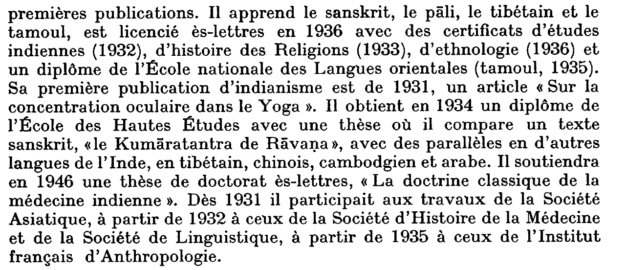
How did Jean Filliozat become a specialist of Tamil? (2)
[obituary (by his son) in 1984 BEFEO (continued)]

Slide 15
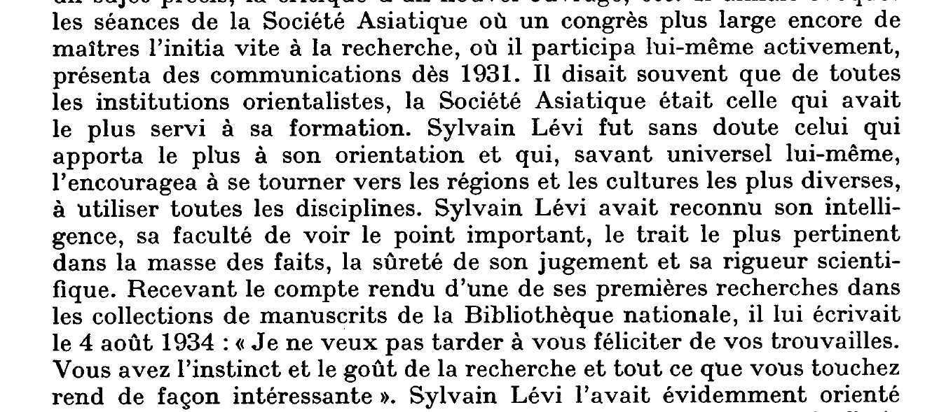
How did Jean Filliozat become a specialist of Tamil? (3)
[obituary (by his son) in 1984 BEFEO (continued)]

Slide 16
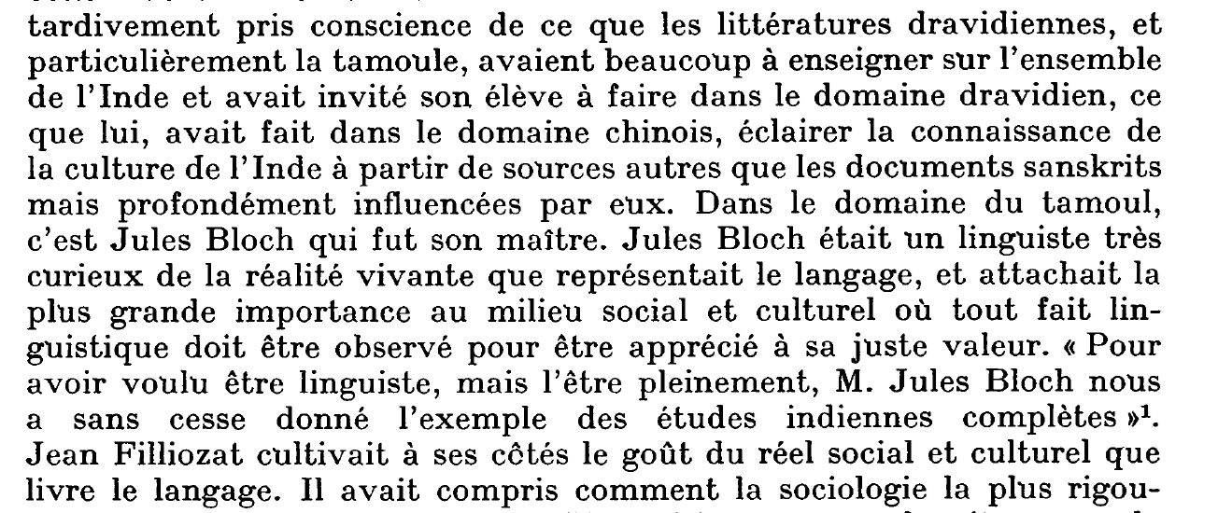
How did Jean Filliozat become a specialist of Tamil? (4)
[obituary (by his son) in 1984 BEFEO (continued)]

Slide 17
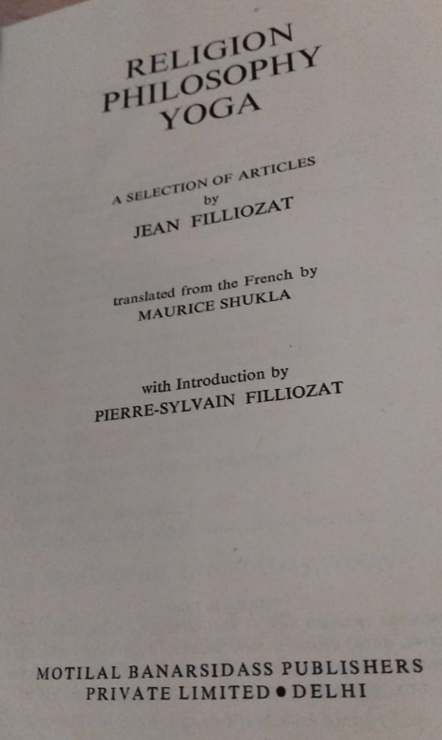
Whom did Jean Filliozat admire? a few names, excerpted from the introduction to RPY (Religion, Philosophy, Yoga, 1991, Motilal Banarsidass), collection of articles translated into English
Maridass Pillai
Anquetil-Duperron
Sylvain Lévi
Jules Bloch
Alfred Foucher

Slide 18
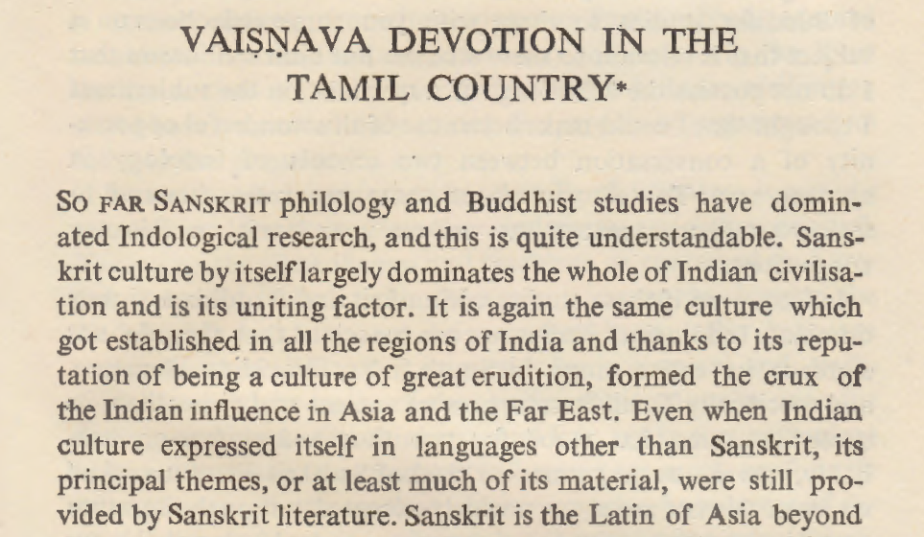
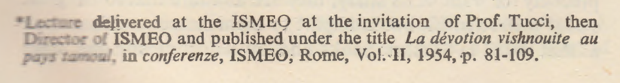
Jean Filliozat and Vaiṣṇavism (Nammāḻvār, 1954, RPY pp.19-40)

Slide 19
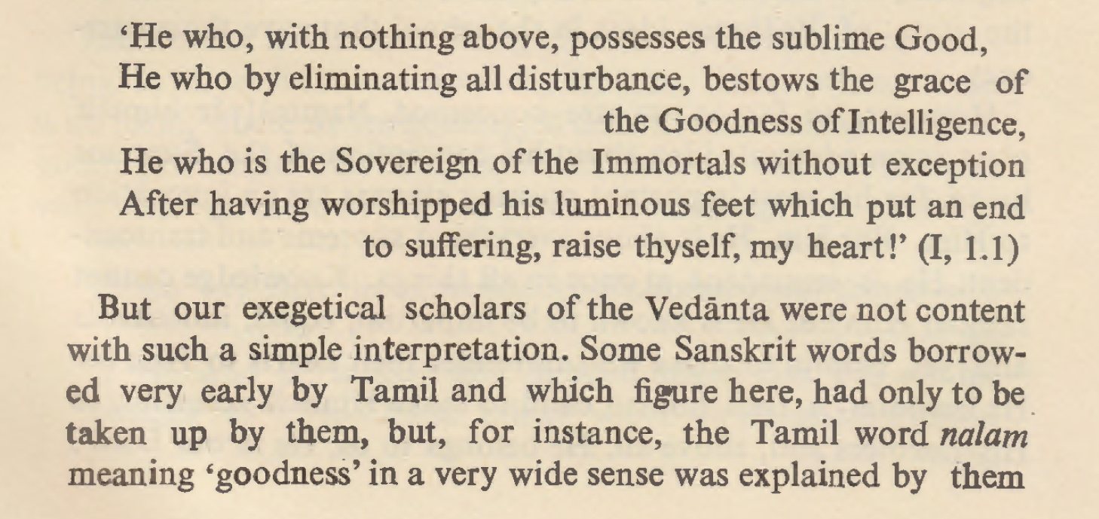
Jean Filliozat and Vaiṣṇavism (Nammāḻvār, 1954)

Slide 20
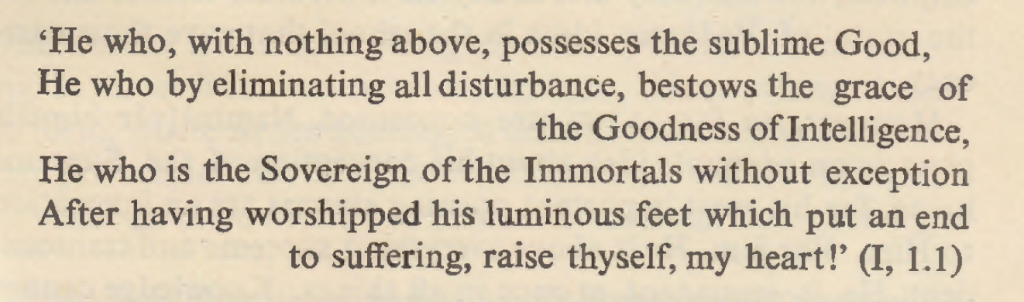
Jean Filliozat and Vaiṣṇavism (Nammāḻvār, 1954)
உயர்வற உயர்நலம் உடையவன் யவன்அவன்
மயர்வற மதிநலம் அருளினன் யவன்அவன்
அயர்வறும் அமரர்கள் அதிபதி யவன்அவன்
துயரறு சுடரடி தொழுதுஎழுஎன் மனனே.

Slide 21
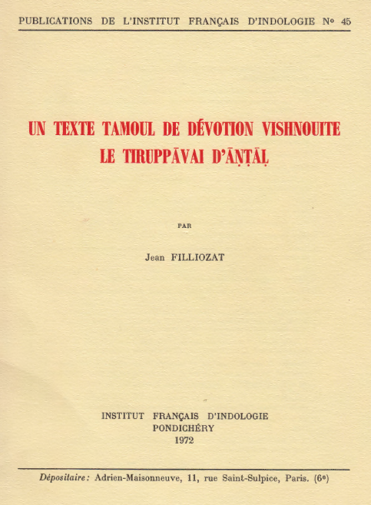
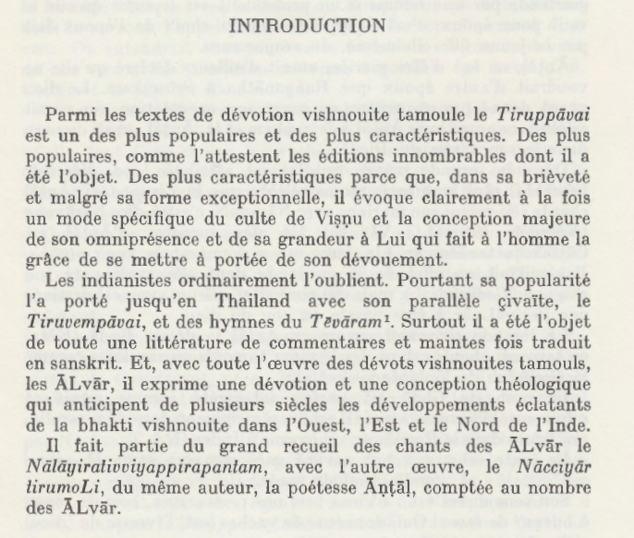
Jean Filliozat and Vaiṣṇavism (Tiruppāvai, 1972)

Slide 22
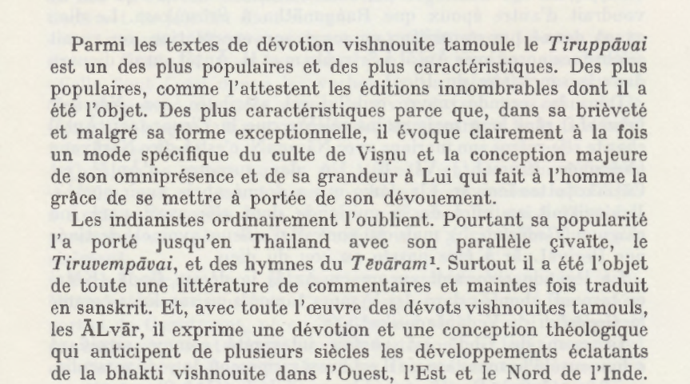
Jean Filliozat and Vaiṣṇavism (Tiruppāvai, 1972)

Slide 23
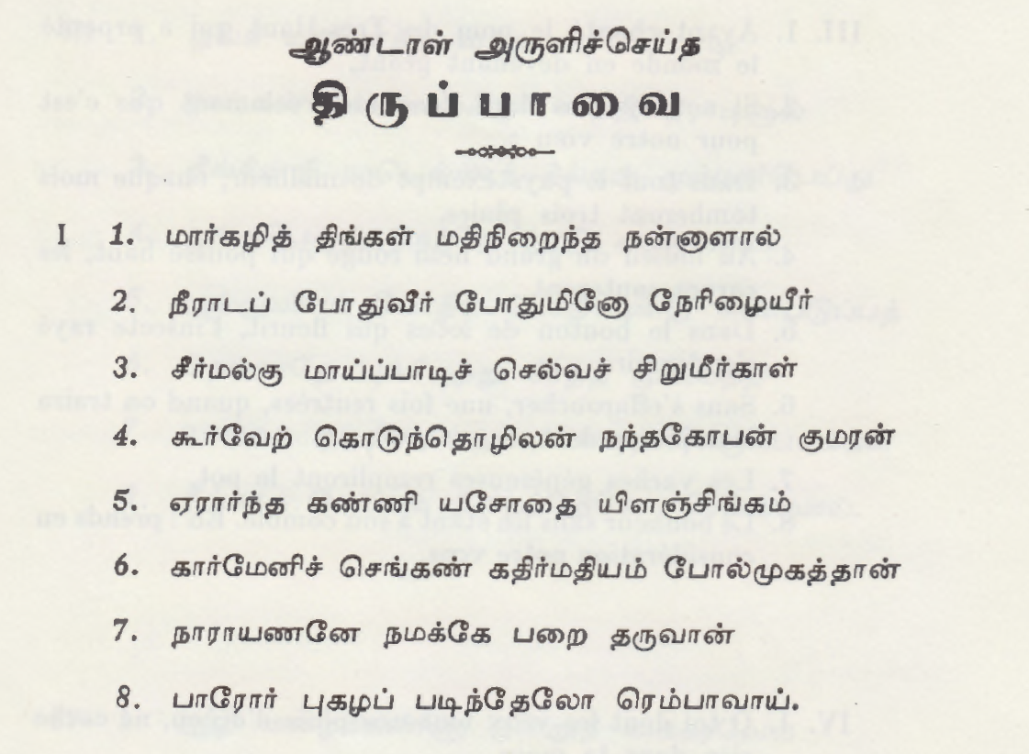
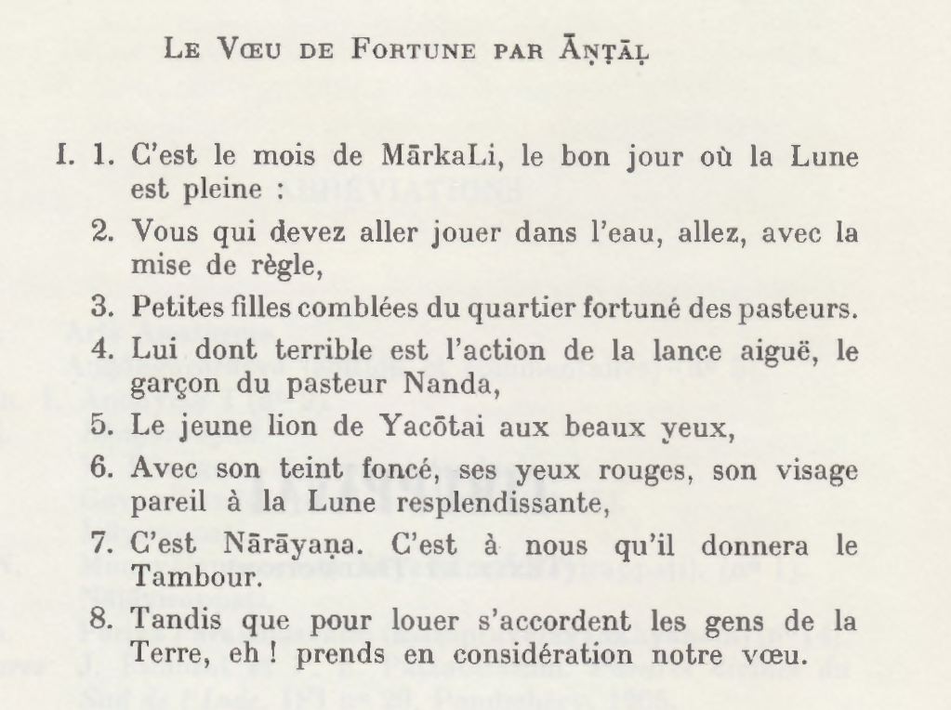
Jean Filliozat and Vaiṣṇavism (Tiruppāvai, 1972)

Slide 24
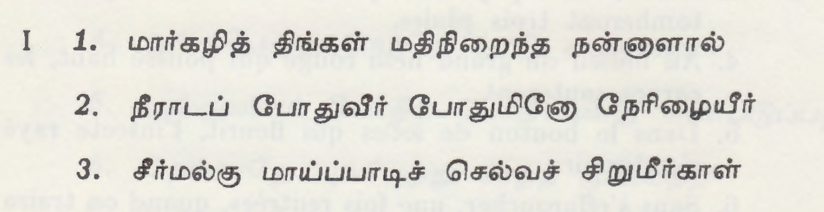
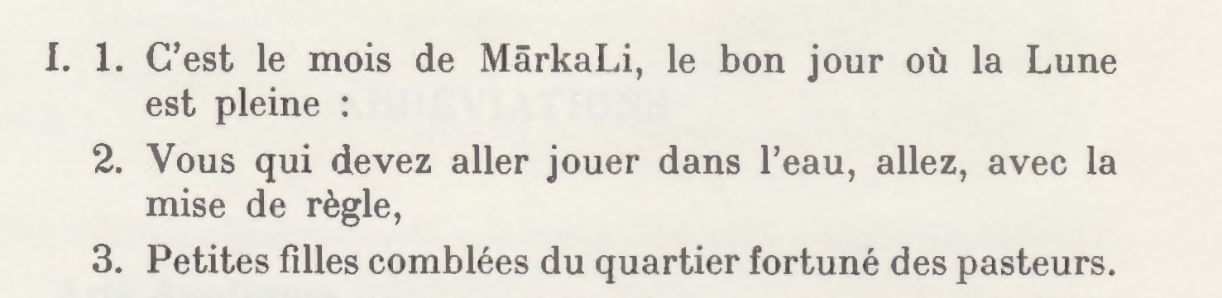
Jean Filliozat and Vaiṣṇavism (Tiruppāvai, 1972)

Slide 25
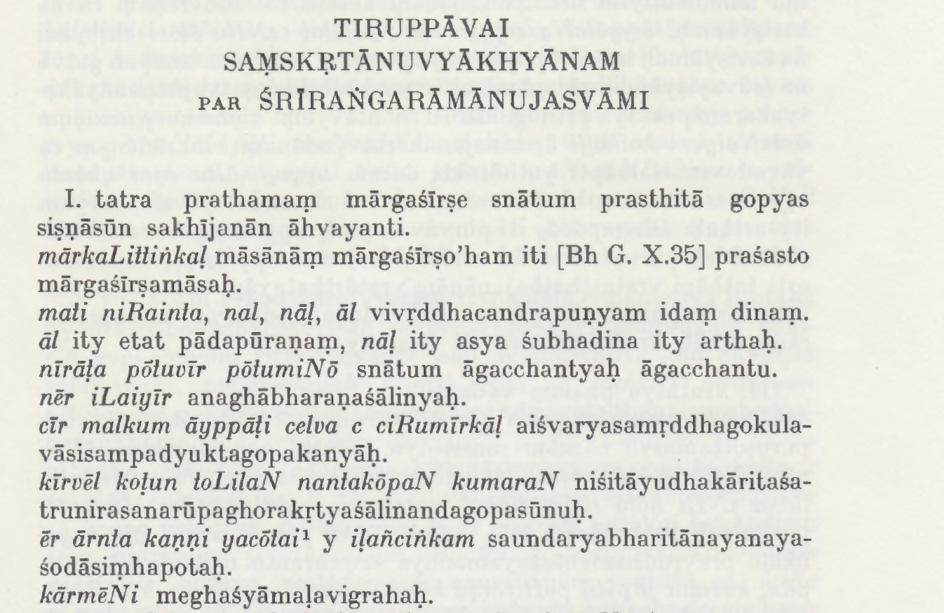
Jean Filliozat and Vaiṣṇavism (Tiruppāvai, 1972)

Slide 26
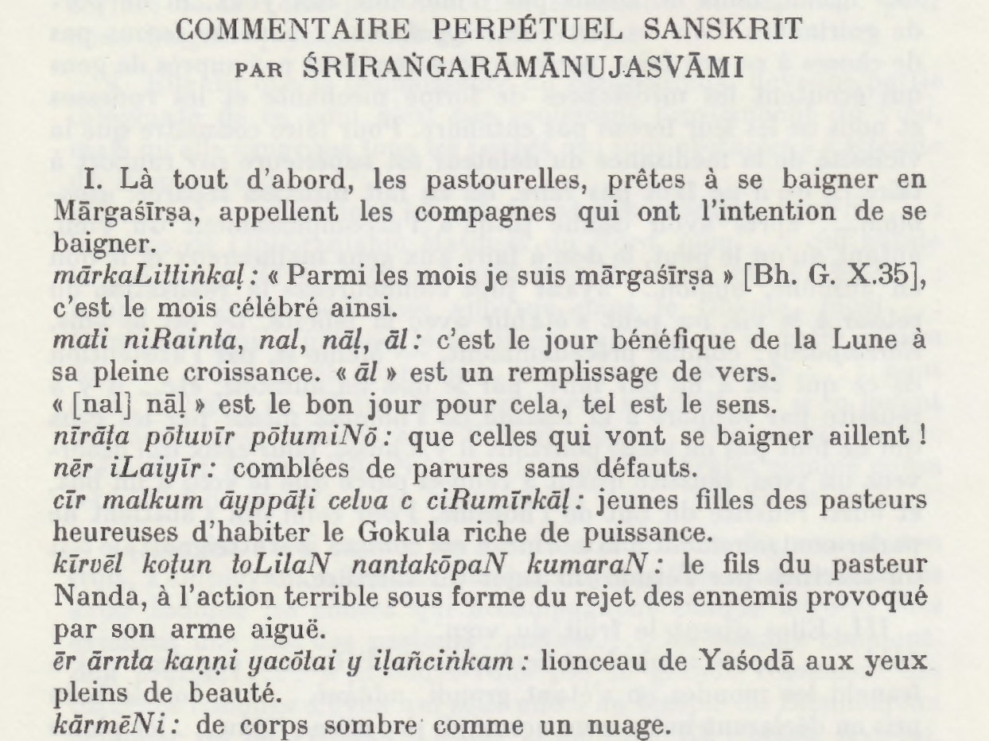
Jean Filliozat and Vaiṣṇavism (Tiruppāvai, 1972)

Slide 27
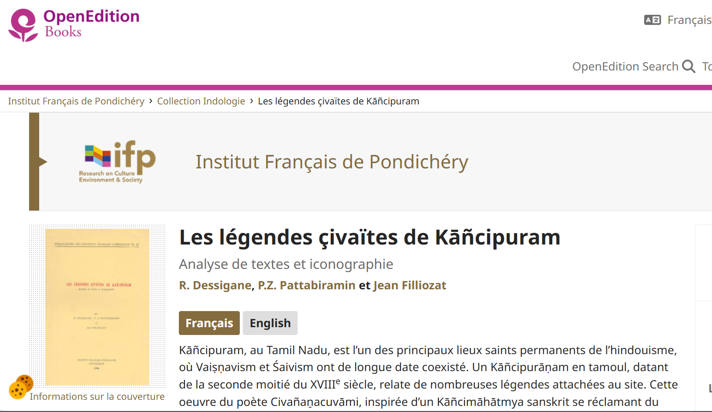
Jean Filliozat in collaboration with others (1964) https://books.openedition.org/ifp/2409

Slide 28
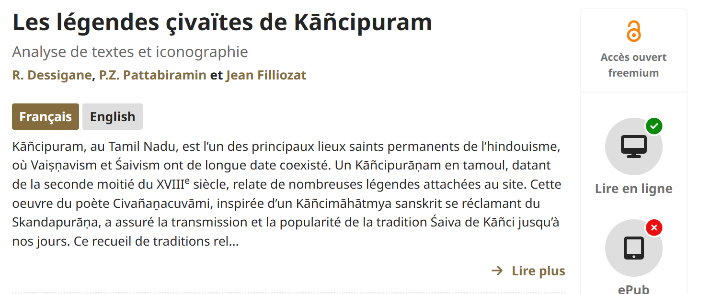
Jean Filliozat in collaboration with others (1964) https://books.openedition.org/ifp/2409

Slide 29
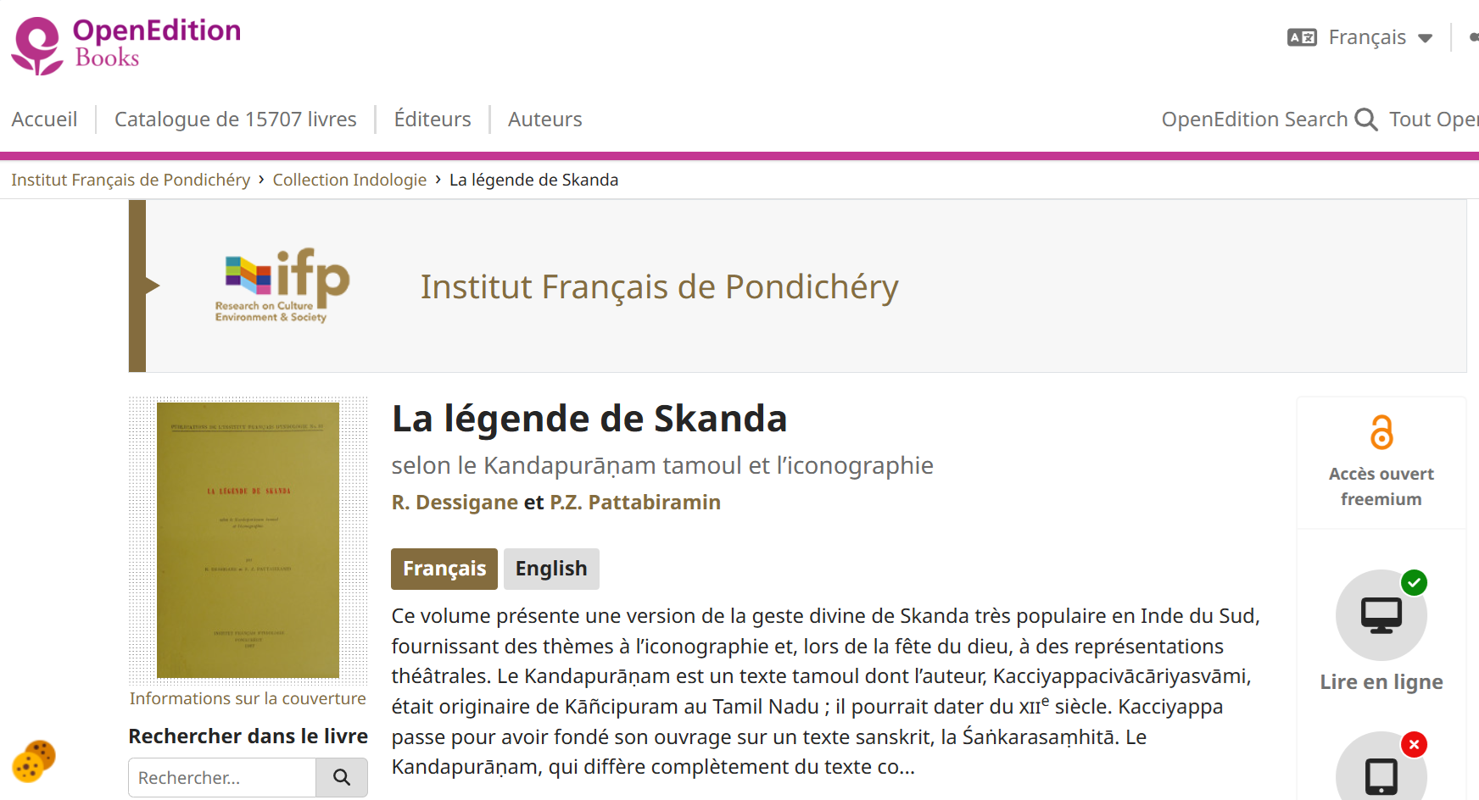
R. Dessigane et P.Z. Pattabiramin (1967) with introduction by Jean Filliozat https://books.openedition.org/ifp/2729

Slide 30
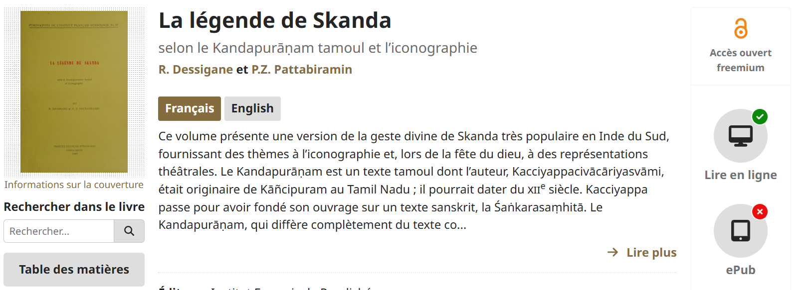
R. Dessigane et P.Z. Pattabiramin (1967) with introduction by Jean Filliozat https://books.openedition.org/ifp/2729

Slide 31
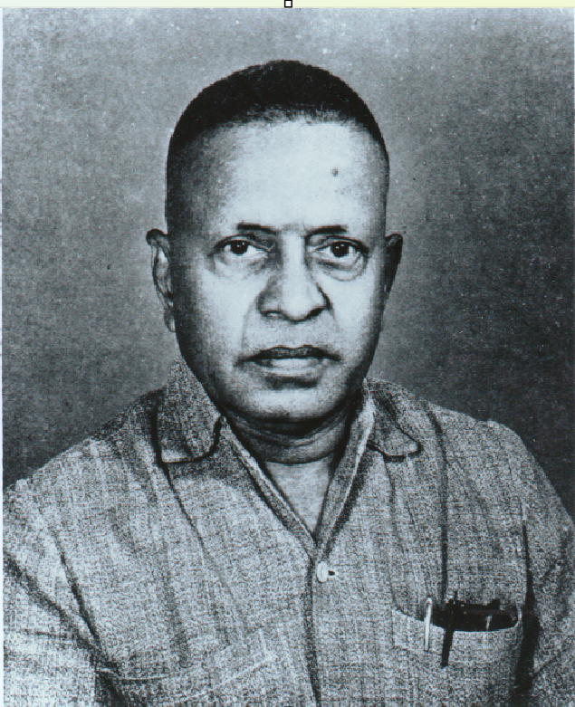
Jean Filliozat in collaboration with others
P.Z. PATTABIRAMIN (1906-1971) [EFEO Member from 1965-1971]
P.Z. Pattabiramin was initiated into archaeology by G. Jouveau-Dubreuil, who was then professor at the Collège de Pondichéry. Fluent in Tamil and Telugu, and also mastering Malayalam, Hindi, French and English, P.Z. Pattabiramin was first G. Jouveau-Dubreuil’s interpreter before becoming his indispensable assistant on archaeological sites. He was, moreover, an unequalled informant regarding everything relating to Indian culture, in particular in the area of Indian legends linked with monuments and iconographic representations. At the demise of G. Jouveau-Dubreuil, P.Z. Pattabiramin continued to collect important documentation at archaeological sites and holy places in South India, while working at the library in Pondicherry (1949-1955).

Slide 32
Jean Filliozat in collaboration with others
P.Z. PATTABIRAMIN (1906-1971) [EFEO Member from 1965-1971]
The founding of the Institut français d’indologie in Pondicherry, in 1955, and then the establishment, in 1956, of the EFEO research centre made it possible for P.Z. Pattabiramin to devote himself entirely to archaeological research. He was detached to work with the Institut in 1956, and became a member of the EFEO in 1965, for which he carried out several missions, beginning in 1961. In this framework, he was above all responsible for the collection of images by the photography of temples and their representations: the photographic archives of the Institut came to be. Until his death in 1971, his knowledge of archaeological sites and of the holy places in the South enabled of the collection of nearly 70 000 photographs. His work was continued by Françoise L’Hernault.

Slide 33
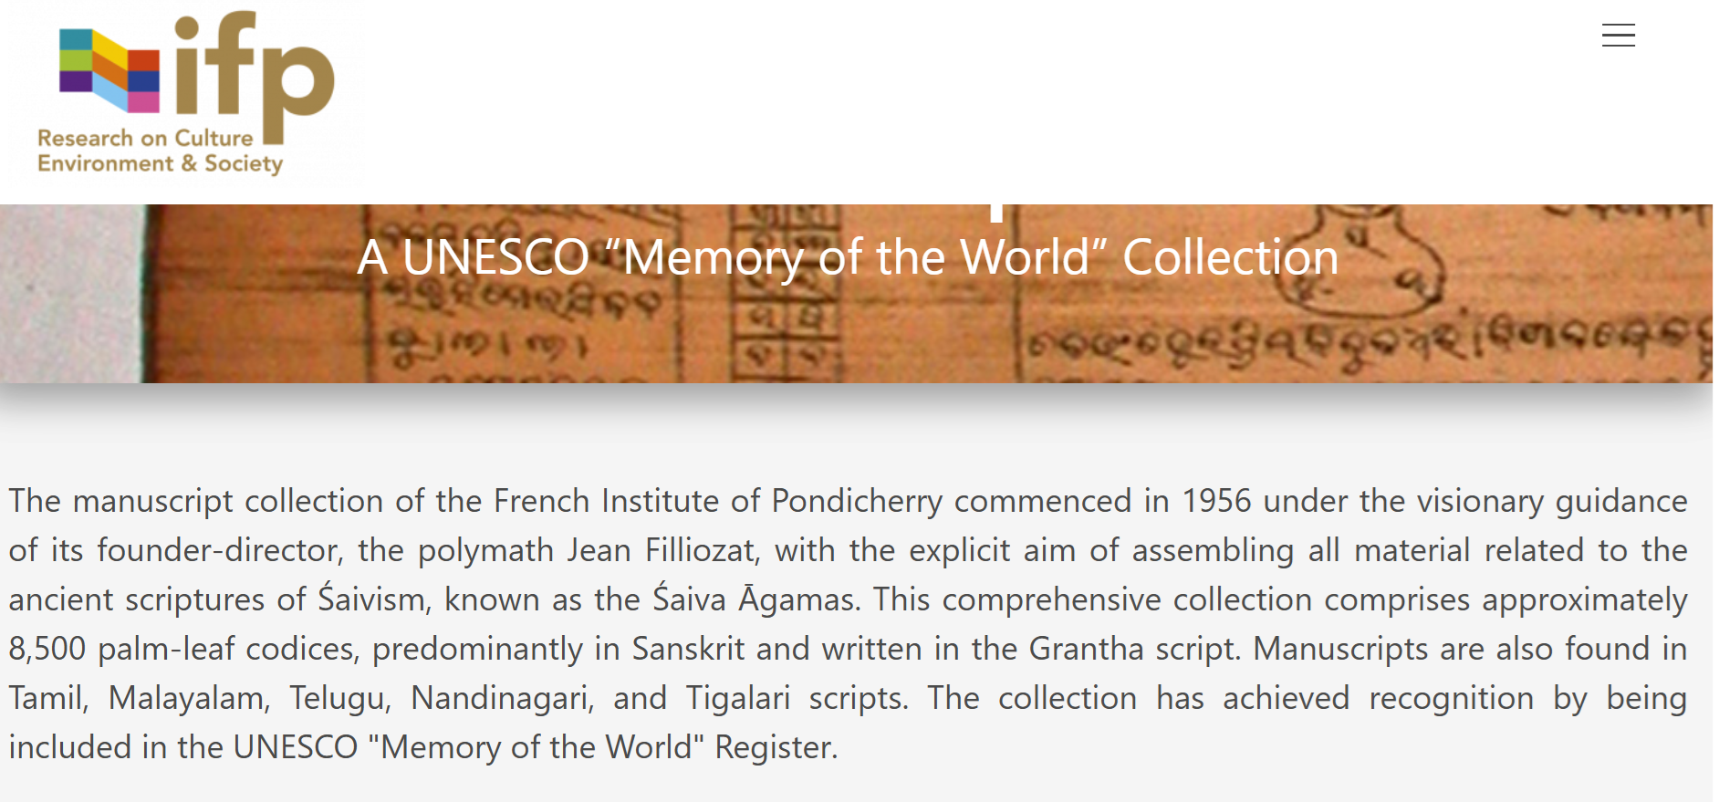
Jean Filliozat and the collecting of indian MSS https://www.ifpindia.org/resources/manuscripts

Slide 34
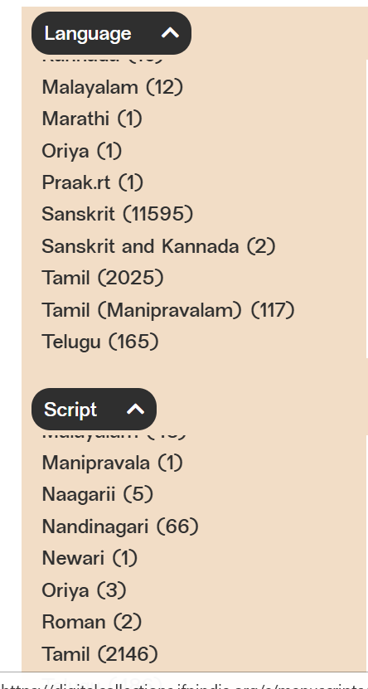
https://www.ifpindia.org/resources/manuscripts
The manuscript collection of the French Institute of Pondicherry commenced in 1956 under the visionary guidance of its founder-director, the polymath Jean Filliozat, […] This comprehensive collection comprises approximately 8,500 palm-leaf codices, predominantly in Sanskrit and written in the Grantha script. Manuscripts are also found in Tamil, Malayalam, Telugu, Nandinagari, and Tigalari scripts. The collection has achieved recognition by being included in the UNESCO "Memory of the World" Register.

Slide 35

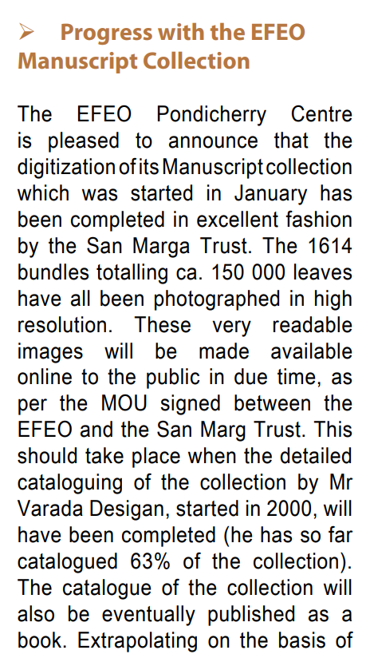
The Pondicherry EFEO collection of MSS https://www.ifpindia.org/media/documents/pattrika_36.pdf

Slide 36
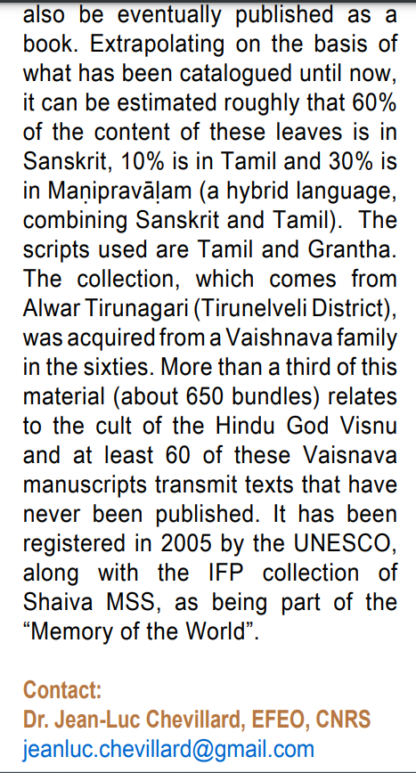
The Pondicherry EFEO collection of MSS https://www.ifpindia.org/media/documents/pattrika_36.pdf

Slide 37

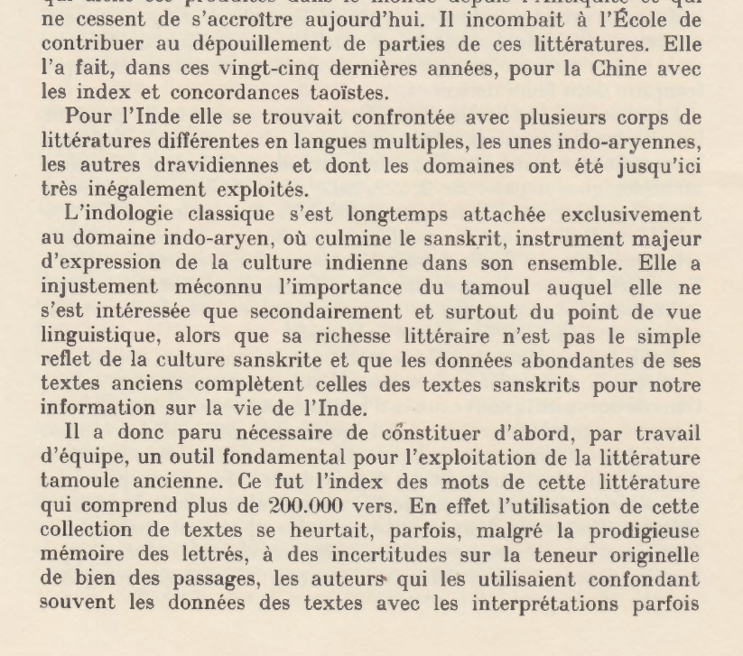
Jean Filliozat et la lexicographie tamoule (1976 assessment)

Slide 38
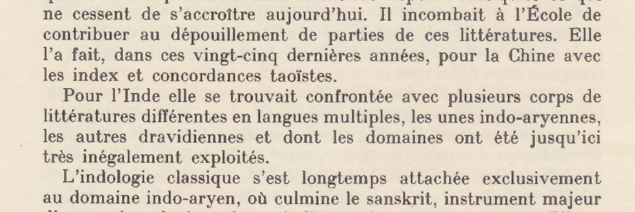
Jean Filliozat et la lexicographie tamoule
(1976 assessment)

Slide 39
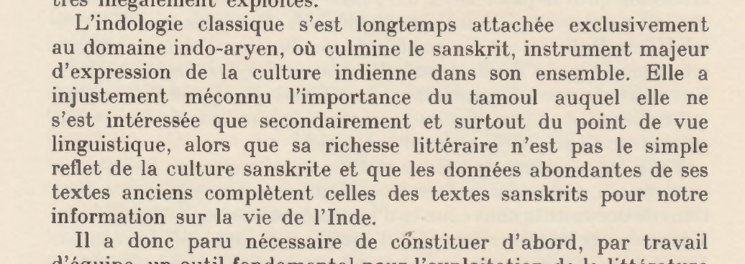
Jean Filliozat et la lexicographie tamoule
(1976 assessment)

Slide 40
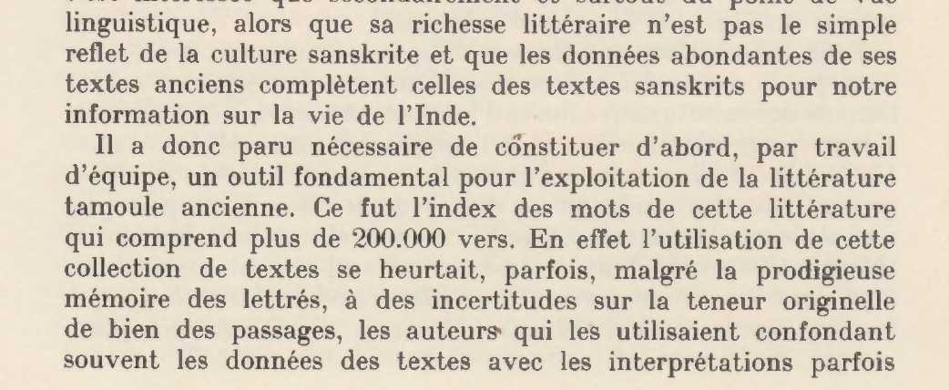
Jean Filliozat et la lexicographie tamoule
(1976 assessment)

Slide 41
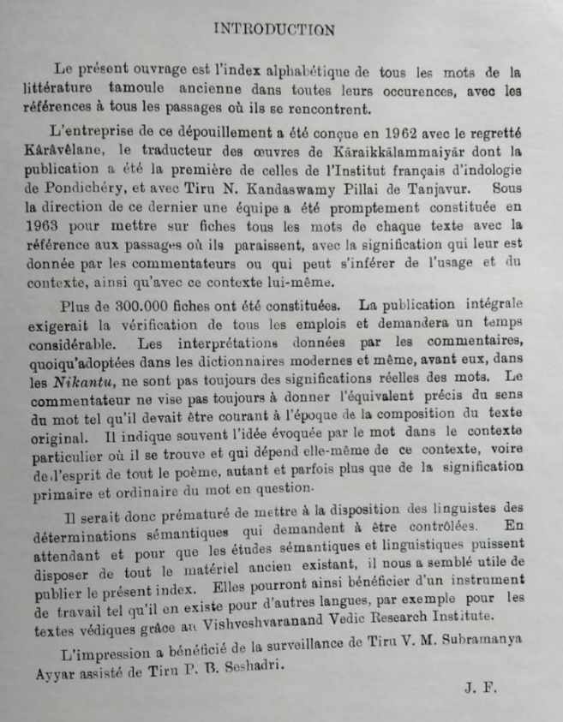
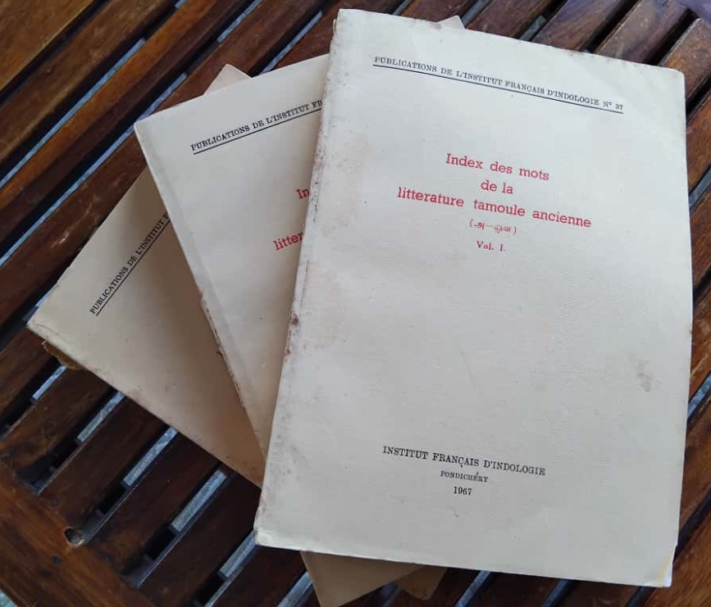
Jean Filliozat et la lexicographie tamoule
(1967-1968-1970)

Slide 42
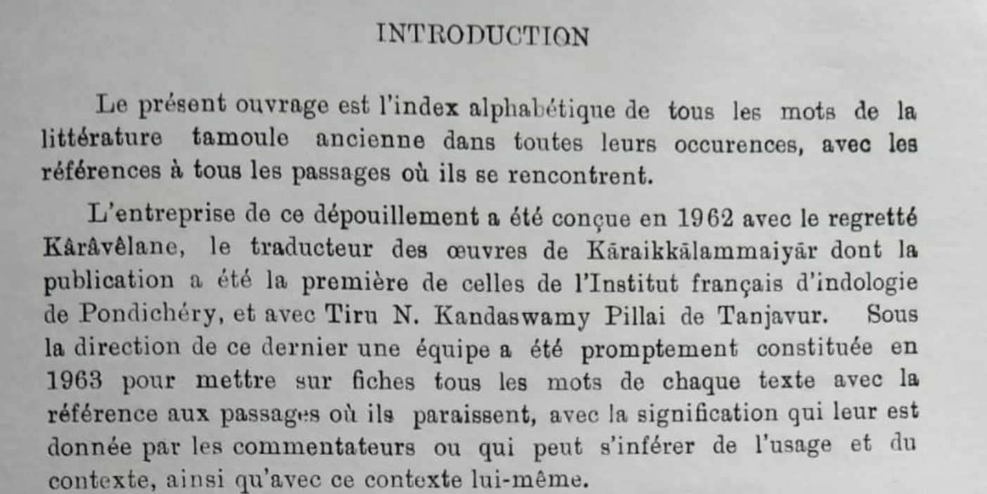
Jean Filliozat et la lexicographie tamoule (1967 introduction)

Slide 43
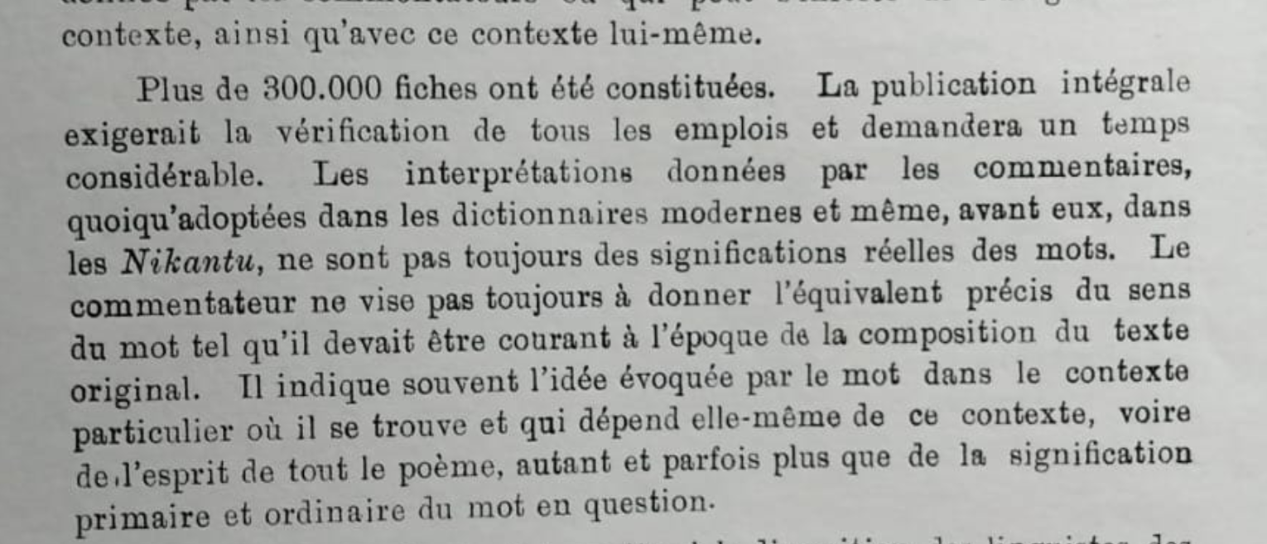
Jean Filliozat et la lexicographie tamoule (1967 introduction)

Slide 44
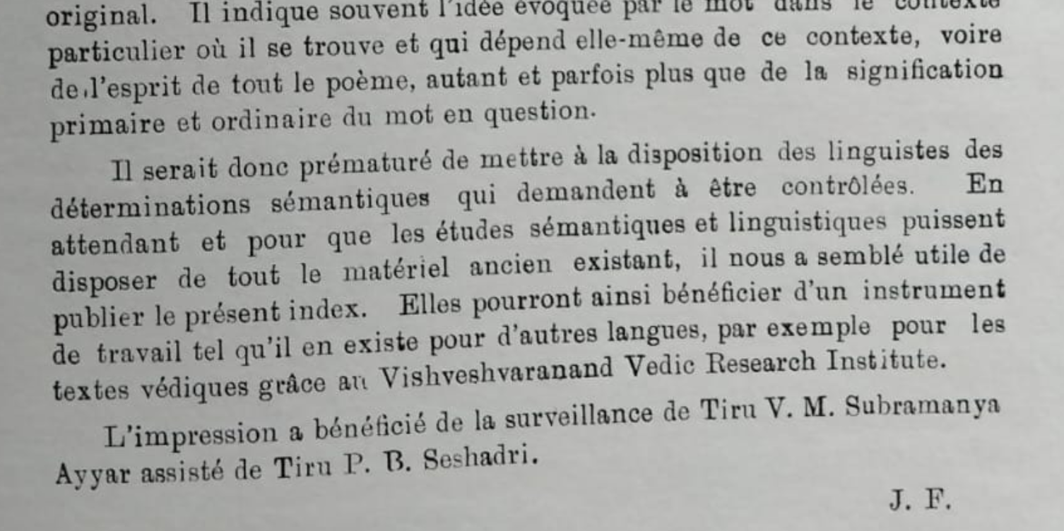
Jean Filliozat et la lexicographie tamoule (1967 introduction)

Slide 45

Jean Filliozat‘s efforts in a larger context
IMTLA (1967-1968-1970) vs. VMTIPA (2001)

Slide 46


Jean Filliozat‘s efforts in a larger context
IMTLA (1967-1968-1970) vs. VMTIPA (2001)

Slide 47


Jean Filliozat et l‘étude des sources latines sur l‘Inde (1980)

Slide 48

Jean Filliozat et l‘étude des sources latines sur l‘Inde (1980)

Slide 49

Jean Filliozat et l‘étude des sources latines sur l‘Inde (1980)

Slide 50

Jean Filliozat et l‘étude des sources latines sur l‘Inde (1980)

Slide 51


Jean Filliozat et l‘étude des sources latines sur l‘Inde (1986)

Slide 52

Jean Filliozat et l‘étude des sources latines sur l‘Inde (1986, posthume)

Slide 53

Jean Filliozat et l‘étude des sources latines sur l‘Inde (1986, posthume)

Slide 54

Jean Filliozat et l‘étude des sources latines sur l‘Inde (1986, posthume)

Slide 55

Jean Filliozat et l‘étude des sources latines sur l‘Inde (1986, posthume)

Slide 56
A few words in support for the future students
(and especially those from the Tamil Diaspora)
Un message pour cette assemblée, adressé tout spécialement aux personnes en position de décision qui sont présentes:
dans le contexte actuel en France, où cela devient très difficile dans beaucoup d'universités de s'inscrire en thèse, si l'on n'a pas d'allocation docctorale, cela serait très positif s'il pouvait y avoir un financement pour quelques allocations doctorales chaque année
நன்றி வணக்கம்

Slide 57
Links
https://www.ifpindia.org/organisation
https://www.academia.edu/3401354/The_Shaiva_Manuscripts_of_Pondicherry_Les_manuscrits_shivaïtes_de_Pondichéry_Dominic_Goodall_and_Jean_Pierre_Muller_
https://www.canalacademies.com/emissions/passion-passe-temps/souvenirs-de-famille/souvenirs-de-famille-jean-filliozat-de-lacademie-des-inscriptions-et-belles-lettres
https://www.tamilvu.org/slet/l4100/l4100pd3.jsp?bookid=73&part=I&pno=57
https://books.openedition.org/ifp/2409
https://books.openedition.org/ifp/2729
https://angkordatabase.asia/authors/jean-filliozat
https://tamilnation.org/forum/sachisrikantha/061020iatr
https://www.unesco.org/archives/multimedia/document-5085
https://thevaaram.org/en/thirumurai_1/songview.php?thiru=11&Song_idField=11004&padhi=040
https://en.wikipedia.org/wiki/Jean_Filliozat
https://www.persee.fr/doc/befeo_0336-1519_1984_num_73_1_1628
https://www.ifpindia.org/resources/manuscripts
https://www.ifpindia.org/media/documents/pattrika_36.pdf

